Slide 1
Module 2: Developing Session Beans
Notes:
Instructor notes:
This title slide introduces a module within the course.
Module 2 : Developing Session Beans

Slide 2

Module Objectives
In this lesson, you will develop session beans.
You will:
  Decide on an appropriate type of session bean.
  Create a remote interface for a session bean.
  Create a session bean implementation class.
  Create a client class for a session bean.
  Deploy a session bean component.
  Create a stateless session bean.
Notes:
Instructor notes:
In this lesson, you will develop session beans.
You will:
Decide on an appropriate type of session bean.
Create a remote interface for a session bean.
Create a session bean implementation class.
Create a client class for a session bean.
Deploy a session bean component.
Create a stateless session bean.

Slide 3
Module Coverage
Topic A: Determine the Appropriate Session Bean Type
Topic B: Create a Remote Interface for a Session Bean
Topic C: Create a Session Bean Implementation Class
Topic D: Create a Session Bean Client
Topic E: Deploy a Session Bean Component
Topic F: Create a Stateless Session Bean
Notes:
Instructor notes:
In this lesson, you will develop session beans.
You will:
Decide on an appropriate type of session bean.
Create a remote interface for a session bean.
Create a session bean implementation class.
Create a client class for a session bean.
Deploy a session bean component.
Create a stateless session bean.

Slide 4
Introduction
After examining the EJB architecture, creating an application plan and identifying the application Requirements, it is now time to learn how to work with different types of beans in order to create a complete application.
This module will discuss how to create a stateful session bean that stores items in a virtual shopping cart and a stateless session bean that creates a recordset of the products displayed on a catalog web page.
For example, if you are working on an e-commerce application that enables customers to select products from a catalog and place an order, you would like your server to receive and process the orders and generate invoices for the customers. If you use session beans to perform this task, you will reduce your application development time, since the server’s EJB container provides many of the system-level services and makes your application more scalable and maintainable.
Notes:
Instuctor notes:
You have examined the EJB architecture, created an application plan, and identified the application requirements. You now need to learn how to work with different types of beans in order
to create a complete application. In this lesson, you will create a stateful session bean that
stores items in a virtual shopping cart and a stateless session bean that creates a recordset of
the products displayed on a catalog web page.
You are working on an e-commerce application that enables customers to select products from
a catalog and place an order. You would like your server to receive and process the orders and
generate invoices for the customers. If you use session beans to perform this task, you will
reduce your application development time, since the server’s EJB container provides many of
the system-level services and makes your application more scalable and maintainable.

Slide 5
Topic A: Determine the Appropriate Session Bean Type
Having examined the different types of beans that be can used to create an application, the user should also be able to identify the most appropriate type of beans needed in one’s application.
In this topic, you will select the appropriate type of session bean to use for the Shopping Cart module of your application.
Let’s say that you have decided to buy a new car from a car dealership:
  You can either finance the car for 36 months at 5.9 percent interest or for 60 months at 7.9 percent interest.
  If you choose the 60-month option, your payments are lower but the total of all the payments is higher.
  If you choose the 36-month plan, you’ll spend less money overall, but more each month.
  Like selecting car financing, choosing the right type of session bean to efficiently manage your bean’s state between invocations requires you to carefully evaluate the needs and goals of your application.
Notes:
Instuctor notes:
You have examined the different types of beans that you can use to create an application. You
should also be able to identify the most appropriate type of beans that you need to use in your
application. In this topic, you will select the appropriate type of session bean to use for the
Shopping Cart module of your application.
Let’s say that you have decided to buy a new car from a car dealership. You can either finance
the car for 36 months at 5.9 percent interest or for 60 months at 7.9 percent interest. If you
choose the 60-month option, your payments are lower but the total of all the payments is
higher. If you choose the 36-month plan, you’ll spend less money overall, but more each
month. Like selecting car financing, choosing the right type of session bean to efficiently manage
your bean’s state between invocations requires you to carefully evaluate the needs and
goals of your application.

Slide 6
The States of a Stateless Session Bean
Stateless session beans exist in two states: the Does Not Exist state and the Method Ready Pool state.
Stateless Session Bean State | Description
Does Not Exist state | Bean instance has not yet been created and is not present in the memory.
Method Ready Pool state | Bean instance has been created by the EJB container and automatically set to this state.
Notes:
Instuctor notes:
Stateless session beans exist in two states: the Does Not Exist state and the Method Ready Pool state.
Stateless Session Bean State and Description
Does Not Exist state - Bean instance has not yet been created and is not present in the memory.
Method Ready Pool state - Bean instance has been created by the EJB container and automatically set to this state.

Slide 7
The States of a Stateful Session Bean
Stateful session beans exist in three states: the Does Not Exist, Method Ready Pool, and Passivated states.
Stateless Session Bean State | Description
Does Not Exist state | Bean instance has not yet been created and is not present in the memory.
Method Ready Pool state | Bean instance has been created by the EJB container and automatically set to this state.
Passivated state | Bean instance exists in this state during periods of inactivity between client requests.
Notes:
Instuctor notes:
Stateful session beans exist in three states: the Does Not Exist, Method Ready Pool, and Passivated states.
Stateful Session Bean and State Description
Does Not Exist state - Bean instance has not yet been created and is not present in the memory.
Method Ready Pool state - Bean instance has been created by the EJB container and automatically set to this state.
Passivated state - Bean instance exists in this state during periods of inactivity between client requests.

Slide 8
How to Determine the Appropriate Session Bean
Type (1/3)
Two types of session beans:
  Stateful session beans
  Stateless session beans
Choosing the appropriate type of session bean will help you reduce your application development time, efficiently manage your bean’s state between invocations, and make your application more scalable and maintainable.
Guidelines
Follow these guidelines to determine what type of session bean you should use.
Use a stateful session bean if:
  The bean stores data for one specific client—such as a web browser session.
  The bean stores data during the span of several method invocations.
Notes:
Instuctor notes:
There are two types of session beans: stateful session beans and stateless session beans.
Choosing the appropriate type of session bean will help you reduce your application development
time, efficiently manage your bean’s state between invocations, and make your
application more scalable and maintainable.
Guidelines
Follow these guidelines to determine what type of session bean you should use.
Use a stateful session bean if:
• The bean stores data for one specific client—such as a web browser session.
• The bean stores data during the span of several method invocations.
Use a stateless session bean if:
• The bean does not store data for a specific client.
• The bean exists for a single method invocation.
• The bean is used to get data from a database.

Slide 9
How to Determine the Appropriate Session Bean
Type (2/3)
Use a stateless session bean if:
  The bean does not store data for a specific client.
  The bean exists for a single method invocation.
  The bean is used to get data from a database.
Notes:
Instuctor notes:
There are two types of session beans: stateful session beans and stateless session beans.
Choosing the appropriate type of session bean will help you reduce your application development
time, efficiently manage your bean’s state between invocations, and make your
application more scalable and maintainable.
Guidelines
Follow these guidelines to determine what type of session bean you should use.
Use a stateful session bean if:
• The bean stores data for one specific client—such as a web browser session.
• The bean stores data during the span of several method invocations.
Use a stateless session bean if:
• The bean does not store data for a specific client.
• The bean exists for a single method invocation.
• The bean is used to get data from a database.

Slide 10
How to Determine the Appropriate Session Bean
Type (3/3)
Example: Stateless Session Bean Example
A development team is creating an enterprise bean to display messages on a message board. Messages are stored in a database and can be viewed by any user of the message board. The team chooses to use a stateless session bean to retrieve the messages from the database because the message board will not be storing data for a specific client and is just retrieving the message records from the database.
Example: Stateful Session Bean Example
Consider an online shopping application. As users browse through the online catalog, they can add items to their virtual shopping cart. Developers often use stateful session beans to store the items in a shopping cart, because stateful session beans store data for a single client (the web shopper) and span multiple method invocations (the calls to the method that adds items to the shopping cart).
Notes:
Instuctor notes:
Example: Stateless Session Bean Example
A development team is creating an enterprise bean to display messages on a message
board. Messages are stored in a database and can be viewed by any user of the message
board. The team chooses to use a stateless session bean to retrieve the messages
from the database because the message board will not be storing data for a specific
client and is just retrieving the message records from the database.
Example: Stateful Session Bean Example
Consider an online shopping application. As users browse through the online catalog,
they can add items to their virtual shopping cart. Developers often use stateful session
beans to store the items in a shopping cart, because stateful session beans store data
for a single client (the web shopper) and span multiple method invocations (the calls to
the method that adds items to the shopping cart).

Slide 11
Discovery Activity 2-1
Scenario:
Your company has begun the process of developing an online e-commerce application for a client. In the application plan, you have decided to use a session bean for the application’s Shopping Cart module.
As per the client’s requirements, customers should have their own cart and should be able to add or remove items from it.
As the customer shops, the cart should keep track of its contents.
At any time while using the cart, the customer should be able to get a list of the items in the cart.
When the customer has completed his/her shopping, the cart will be returned to the store.
You must analyze these requirements and decide which type of bean to use for the Shopping Cart module.
Notes:
Instuctor notes:
Scenario:
Your company has begun the process of developing an online e-commerce application for a
client. In the application plan, you have decided to use a session bean for the application’s
Shopping Cart module. As per the client’s requirements, customers should have their own cart
and should be able to add or remove items from it. As the customer shops, the cart should
keep track of its contents. At any time while using the cart, the customer should be able to get
a list of the items in the cart. When the customer has completed his/her shopping, the cart will
be returned to the store.
You must analyze these requirements and decide which type of bean to use for the Shopping
Cart module.

Slide 12
Discovery Activity 2-1
Creating An Action Plan
1. Which type of session bean could you use to create the application’s Shopping Cart module? | You would use a stateful session bean, because stateless session beans are dedicated to a single client, and data stored in a stateful session bean persists through multiple client interactions.
2. Why would you not choose a stateless session bean? | You would not choose a stateless session bean because they are not dedicated to one client and the container destroys the session bean instance when the request for one of its business methods is completed.
3. What are the advantages of using a stateful session bean in this situation? | Stateful session beans serve a single client at a time. They are usually developed to act as agents for the client, managing the interaction of other beans and performing work on behalf of the client application.
Notes:
Instuctor notes:
1. Which type of session bean could you use to create the application’s Shopping Cart
module?
You would use a stateful session bean, because stateless session beans are dedicated to a
single client, and data stored in a stateful session bean persists through multiple client
interactions.
2. Why would you not choose a stateless session bean?
You would not choose a stateless session bean because they are not dedicated to one client
and the container destroys the session bean instance when the request for one of its
business methods is completed.
3. What are the advantages of using a stateful session bean in this situation?
Stateful session beans serve a single client at a time. They are usually developed to act as
agents for the client, managing the interaction of other beans and performing work on
behalf of the client application.

Slide 13
Topic B: Create a Remote Interface for a
Session Bean
You have identified the type of session bean that you will use in your application’s Shopping Cart module and are ready to begin the development of the session bean.
As your application will be accessed by remote clients, you need to establish a remote interface with the necessary bean life cycle methods in order to access the session bean. In this topic, you will create a remote interface for your session bean that will declare the various business methods used by the application and enable the remote clients to access the bean.
You are on a business trip outside your city. You have painstakingly prepared your monthly expense report, as you need to file it on time. However, you are unable to access your company’s intranet because of a network problem. As a result, you are unable to submit your report until you are able to establish communication with your company’s intranet. Similarly, unless you create a remote interface for a session bean, your clients will not be able to access the application remotely.
Notes:
Instuctor notes:
You have identified the type of session bean that you will use in your application’s Shopping
Cart module and are ready to begin the development of the session bean. As your application
will be accessed by remote clients, you need to establish a remote interface with the necessary
bean life cycle methods in order to access the session bean. In this topic, you will create a
remote interface for your session bean that will declare the various business methods used by
the application and enable the remote clients to access the bean.
You are on a business trip outside your city. You have painstakingly prepared your monthly
expense report, as you need to file it on time. However, you are unable to access your company’s
intranet because of a network problem.As a result, you are unable to submit your report
until you are able to establish communication with your company’s intranet. Similarly, unless
you create a remote interface for a session bean, your clients will not be able to access the
application remotely.

Slide 14
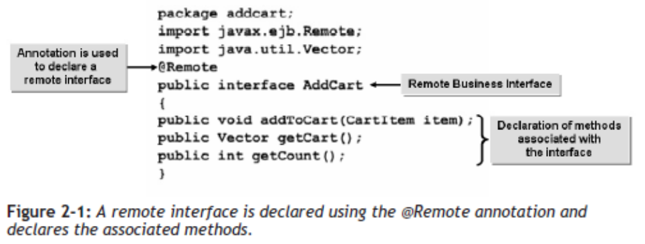
Remote Business Interface
The remote business interface implemented for the session bean requires the javax.ejb.Remote API to be imported into the file. The package in which the interface resides should also be specified.
The @Remote annotation is used to declare a remote interface. The name of the remote interface should be the same as that of the .java file in which it is saved. The interface can also be used to declare the methods that are associated with it.
The @Remote Annotation
The @Remote annotation is used to indicate a remote business interface. The annotation automatically generates the interface and makes development much easier.
Notes:
Instuctor notes:
The remote business interface implemented for the session bean requires the
javax.ejb.Remote API to be imported into the file. The package in which the interface
resides should also be specified.
The @Remote annotation is used to declare a remote interface. The name of the remote interface
should be the same as that of the .java file in which it is saved. The interface can also be
used to declare the methods that are associated with it.
Figure 2-1: A remote interface is declared using the @Remote annotation and
declares the associated methods.
The @Remote Annotation
The @Remote annotation is used to indicate a remote business interface. The annotation
automatically generates the interface and makes development much easier.

Slide 15
The Business Methods
Business methods are declared in the remote business interface to help a session bean achieve the desired functionality.
For example, a developer of an online shopping application would use the addToCart(), getCart(), getCount(), and getProductList() methods.
Business Method | Description
addToCart() | Stores the details of products selected by the customer.
getCart() | Returns the cart’s content.
getCount() | Returns the count of items in a cart.
getProductList() | Returns the list of available products.
Notes:
Instuctor notes:
Business methods are declared in the remote business interface to help a session bean achieve the desired functionality.
For example, a developer of an online shopping application would use the addToCart(), getCart(), getCount(), and getProductList() methods.
Business Methods and Description
addToCart() Stores the details of products selected by the customer.
getCart() Returns the cart’s content.
getCount() Returns the count of items in a cart.
getProductList() Returns the list of available products.

Slide 16
How to Create a Remote Interface for a Session
Bean
Procedure Reference: Create a Remote Business Interface for a Session Bean
To create a remote business interface for a session bean:
  Create a source code file that imports the packages that contain the methods needed to implement the session bean’s functionality.
  Declare a remote interface using the @Remote annotation.
  Declare an interface.
  Declare the business methods within the interface.
  Compile and debug the interface.
Notes:
Instuctor notes:
Procedure Reference: Create a Remote Business Interface for a Session Bean
To create a remote business interface for a session bean:
1. Create a source code file that imports the packages that contain the methods
needed to implement the session bean’s functionality.
2. Declare a remote interface using the @Remote annotation.
3. Declare an interface.
4. Declare the business methods within the interface.
5. Compile and debug the interface.

Slide 17
Activity 2-2
Activity Time: 5 minutes
Data Files: AddCart.java
Before You Begin: From C:\085593Data\Developing Session Beans\Activity 2\Starter\stateful\addcart, open AddCart.java.
Notes:
Instuctor notes:
Activity Time: 5 minutes
Data Files: AddCart.java
Before You Begin: From C:\085593Data\Developing Session Beans\Activity 2\Starter\stateful\addcart, open AddCart.java.
Scenario:
You have decided to use a stateful session bean for the Shopping Cart module of the online shopping application that your firm is developing.
From the application plan, you are aware that customers who have logged in should have their own temporary storage memory to keep track of their selections.
A new cart needs to be generated for each customer and should be able to store the product code, product description, product discount, and product price.
As the first step in the development of the Shopping Cart module of your application, you have to create the shopping cart session bean’s remote interface.
Your shopping cart application will be able to add items to the cart, return a list of items in the cart, and return a count of the items in the cart.

Slide 18
Activity 2-2
Scenario:
You have decided to use a stateful session bean for the Shopping Cart module of the online shopping application that your firm is developing.
From the application plan, you are aware that customers who have logged in should have their own temporary storage memory to keep track of their selections.
A new cart needs to be generated for each customer and should be able to store the product code, product description, product discount, and product price.
As the first step in the development of the Shopping Cart module of your application, you have to create the shopping cart session bean’s remote interface.
Your shopping cart application will be able to add items to the cart, return a list of items in the cart, and return a count of the items in the cart.
Notes:
Instuctor notes:
Activity Time: 5 minutes
Data Files: AddCart.java
Before You Begin: From C:\085593Data\Developing Session Beans\Activity 2\Starter\stateful\addcart, open AddCart.java.
Scenario:
You have decided to use a stateful session bean for the Shopping Cart module of the online shopping application that your firm is developing.
From the application plan, you are aware that customers who have logged in should have their own temporary storage memory to keep track of their selections.
A new cart needs to be generated for each customer and should be able to store the product code, product description, product discount, and product price.
As the first step in the development of the Shopping Cart module of your application, you have to create the shopping cart session bean’s remote interface.
Your shopping cart application will be able to add items to the cart, return a list of items in the cart, and return a count of the items in the cart.

Slide 19
Activity 2-2
What You Do | How You Do It
Import the packages that contain the methods you need to implement the functionality of the Shopping Cart module of your application. | Click after package addcart; and press Enter. Import the javax.ejb.Remote and java.util.Vector packages. See Code Sample 1.
Code Sample 1 import javax.ejb.Remote; import java.util.Vector;
Notes:
Instuctor notes:
What You Do
Import the packages that contain the methods you need to implement the functionality of the Shopping Cart module of your application.
How You Do It
Click after package addcart; and press Enter.
Import the javax.ejb.Remote and java.util.Vector packages.
See Code Sample 1.
Code Sample 1
import javax.ejb.Remote;
import java.util.Vector;

Slide 20
Activity 2-2
What You Do | How You Do It
Create an interface called AddCart and declare the addToCart(), getCart(), and getCount() methods needed for the Shopping Cart module. | Type @Remote and press Enter to declare a remote interface. Declare the AddCart interface. See Code Sample 2.
Code Sample 2 public interface AddCart { }
Notes:
Instuctor notes:
What You Do
Create an interface called AddCart and declare the addToCart(), getCart(), and getCount() methods needed for the Shopping Cart module.
How You Do It
a. Type
@Remote
and press Enter to declare a remote interface.
b. Declare the AddCart interface.
See Code Sample 2.
c. In the AddCart interface declaration, click after { and press Enter.
d. Type
public void addToCart(CartItem
item);
and press Enter to declare a method
called addToCart() that takes an
instance of the CartItem class.
e. Type
public Vector getCart();
and press Enter to declare a method
called getCart() that returns a Vector
containing the items in the cart.
f. Type
public int getCount();
to declare a method called getCount()
that returns int.
g. Save and close the file

Slide 21
Activity 2-2
What You Do | How You Do It
Create an interface called AddCart and declare the addToCart(), getCart(), and getCount() methods needed for the Shopping Cart module. | In the AddCart interface declaration, click after { and press Enter. Type public void addToCart(CartItem item); and press Enter to declare a method called addToCart() that takes an instance of the CartItem class.
Notes:
Instuctor notes:
What You Do
Create an interface called AddCart and declare the addToCart(), getCart(), and getCount() methods needed for the Shopping Cart module.
How You Do It
a. Type
@Remote
and press Enter to declare a remote interface.
b. Declare the AddCart interface.
See Code Sample 2.
c. In the AddCart interface declaration, click after { and press Enter.
d. Type
public void addToCart(CartItem
item);
and press Enter to declare a method
called addToCart() that takes an
instance of the CartItem class.
e. Type
public Vector getCart();
and press Enter to declare a method
called getCart() that returns a Vector
containing the items in the cart.
f. Type
public int getCount();
to declare a method called getCount()
that returns int.
g. Save and close the file

Slide 22
Activity 2-2
What You Do | How You Do It
Create an interface called AddCart and declare the addToCart(), getCart(), and getCount() methods needed for the Shopping Cart module. | Type public Vector getCart(); and press Enter to declare a method called getCart() that returns a Vector containing the items in the cart. Type public int getCount(); to declare a method called getCount() that returns int. Save and close the file.
Notes:
Instuctor notes:
What You Do
Create an interface called AddCart and declare the addToCart(), getCart(), and getCount() methods needed for the Shopping Cart module.
How You Do It
a. Type
@Remote
and press Enter to declare a remote interface.
b. Declare the AddCart interface.
See Code Sample 2.
c. In the AddCart interface declaration, click after { and press Enter.
d. Type
public void addToCart(CartItem
item);
and press Enter to declare a method
called addToCart() that takes an
instance of the CartItem class.
e. Type
public Vector getCart();
and press Enter to declare a method
called getCart() that returns a Vector
containing the items in the cart.
f. Type
public int getCount();
to declare a method called getCount()
that returns int.
g. Save and close the file

Slide 23
Topic C: Create a Session Bean Implementation Class
You have created a remote business interface for your session bean. In order to proceed further with the development of the session bean, you need to create a session bean implementation class.
In this topic, you will create a bean implementation class and define the business methods you declared in the remote interface.
Creating a complete bean using the remote interface and the bean implementation class allows you to ensure that the functionality of the bean is complete and focus on the development of other components.
Notes:
Instuctor notes:
You have created a remote business interface for your session bean. In order to proceed further
with the development of the session bean, you need to create a session bean implementation
class. In this topic, you will create a bean implementation class and define the business methods
you declared in the remote interface.
Creating a complete bean using the remote interface and the bean implementation class allows
you to ensure that the functionality of the bean is complete and focus on the development of
other components.

Slide 24
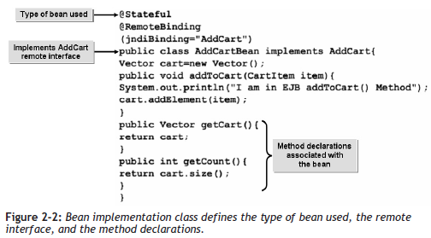
Session Bean Implementation Class (1/2)
The bean implementation class defines the type of bean used, the remote interface being implemented, and the method declarations associated with the bean.
The java.util.*, javax.ejb.*, and org.jboss.annotation.ejb.RemoteBinding APIs need to be imported into the session bean class so as to make the bean fully operational.
Notes:
Instuctor notes:
The bean implementation class defines the type of bean used, the remote interface being implemented,
and the method declarations associated with the bean. The java.util.*,
javax.ejb.*, and org.jboss.annotation.ejb.RemoteBinding APIs need to be
imported into the session bean class so as to make the bean fully operational.
Additionally, the associated bean package should be imported in order to establish a link
between other beans and interfaces that may be present in the package.
Figure 2-2: Bean implementation class defines the type of bean used, the remote
interface, and the method declarations.

Slide 25
Session Bean Implementation Class (2/2)
Additionally, the associated bean package should be imported in order to establish a link between other beans and interfaces that may be present in the package.
Notes:
Instuctor notes:
The bean implementation class defines the type of bean used, the remote interface being implemented,
and the method declarations associated with the bean. The java.util.*,
javax.ejb.*, and org.jboss.annotation.ejb.RemoteBinding APIs need to be
imported into the session bean class so as to make the bean fully operational.
Additionally, the associated bean package should be imported in order to establish a link
between other beans and interfaces that may be present in the package.
Figure 2-2: Bean implementation class defines the type of bean used, the remote
interface, and the method declarations.

Slide 26
Annotations Used
The implementation of session beans has been simplified with the usage of annotations. These annotations automate the creation of stateless and stateful session beans and do not require much coding.
Annotation | Description
@Stateless | Declares the creation of a stateless session bean.
@Stateful | Declares the creation of a stateful session bean.
@RemoteBinding | Binds the session bean implementation class to the remote interface. The attribute jndiBinding should be used to specify the name of the remote interface.
Notes:
Instuctor notes:
The implementation of session beans has been simplified with the usage of annotations. These
annotations automate the creation of stateless and stateful session beans and do not require
much coding.
Annotation Description
@Stateless Declares the creation of a stateless session bean.
@Stateful Declares the creation of a stateful session bean.
@RemoteBinding Binds the session bean implementation class to the
remote interface. The attribute jndiBinding
should be used to specify the name of the remote
interface.

Slide 27
How to Create a Session Bean Implementation
Class
Procedure Reference: Create a Bean Implementation Class
To create a bean implementation class:
  Create a source code file that imports the required packages.
  Declare the creation of a stateful session bean using the @Stateful annotation.
  Declare a session bean class that implements the remote business interface.
  Create the required business methods that would be used to store items in the session bean and retrieve items from the session bean.
  Compile and debug the class.
Notes:
Instuctor notes:
Procedure Reference: Create a Bean Implementation Class
To create a bean implementation class:
1. Create a source code file that imports the required packages.
2. Declare the creation of a stateful session bean using the @Stateful annotation.
3. Declare a session bean class that implements the remote business interface.
4. Create the required business methods that would be used to store items in the session
bean and retrieve items from the session bean.
5. Compile and debug the class.

Slide 28
Activity 2-3
Activity Time: 5 minutes
Data Files: AddCartBean.java
Before You Begin:
  From C:\085593Data\Developing Session Beans\Activity 3\Starter\stateful\addcart, open AddCartBean.java.
  Open a command prompt window and navigate to C:\085593Data\Developing Session Beans\Activity 3\Starter.
Notes:
Instuctor notes:
Activity Time:
5 minutes
Data Files:
• AddCartBean.java
Before You Begin:
1. From C:\085593Data\Developing Session Beans\Activity 3\Starter\stateful\addcart, open
AddCartBean.java.
2. Open a command prompt window and navigate to C:\085593Data\Developing Session
Beans\Activity 3\Starter.
Scenario:
You have created the remote business interface for the Shopping Cart module of your application.
As per the project specifications, the Shopping Cart module should keep track of all the
items that the customer wants to buy. The next step in the process is to create a session bean
class that implements this functionality. The bean should provide a means of storing and
returning items that a user adds to a shopping cart.

Slide 29
Activity 2-3
Scenario:
You have created the remote business interface for the Shopping Cart module of your application.
As per the project specifications, the Shopping Cart module should keep track of all the items that the customer wants to buy.
The next step in the process is to create a session bean class that implements this functionality. The bean should provide a means of storing and returning items that a user adds to a shopping cart.
Notes:
Instuctor notes:
Activity Time:
5 minutes
Data Files:
• AddCartBean.java
Before You Begin:
1. From C:\085593Data\Developing Session Beans\Activity 3\Starter\stateful\addcart, open
AddCartBean.java.
2. Open a command prompt window and navigate to C:\085593Data\Developing Session
Beans\Activity 3\Starter.
Scenario:
You have created the remote business interface for the Shopping Cart module of your application.
As per the project specifications, the Shopping Cart module should keep track of all the
items that the customer wants to buy. The next step in the process is to create a session bean
class that implements this functionality. The bean should provide a means of storing and
returning items that a user adds to a shopping cart.

Slide 30
Activity 2-3
What You Do | How You Do It
Declare a session bean class that implements the SessionBean interface. | Click after package addcart; and press Enter. Import the java.util.*, javax.ejb.*, and org.jboss.annotation.ejb.RemoteBinding packages. See Code Sample 1
Code Sample 1 import java.util.*; import javax.ejb.*; import org.jboss.annotation.ejb.RemoteBinding;
Notes:
Instuctor notes:
What You Do
1. Declare a session bean class that
implements the SessionBean
interface.
How You Do It
1. Declare a session bean class that
implements the SessionBean
interface.
a. Click after package addcart; and
press Enter.
b. Import the java.util.*,
javax.ejb.*, and
org.jboss.annotation.ejb.RemoteBinding
packages.
See Code Sample 1.
c. Type
@Stateful
and press Enter to declare the creation of
a stateful session bean.
d. Bind the session bean implementation
class to the remote business interface
called AddCart.
See Code Sample 2.
e. Add a declaration for a class called
AddCartBean that implements
AddCart, the remote business interface.
See Code Sample 3.
Code Sample 1
import java.util.*;
import javax.ejb.*;
import org.jboss.annotation.ejb.RemoteBinding;
Code Sample 2
@RemoteBinding
(jndiBinding="AddCart")
Code Sample 3
public class AddCartBean implements AddCart
{
}

Slide 31
Activity 2-3
What You Do | How You Do It
Declare a session bean class that implements the SessionBean interface. | Type @Stateful and press Enter to declare the creation of a stateful session bean. Bind the session bean implementation class to the remote business interface called AddCart. See Code Sample 2.
Code Sample 2 @RemoteBinding (jndiBinding="AddCart")
Notes:
Instuctor notes:
What You Do
1. Declare a session bean class that
implements the SessionBean
interface.
How You Do It
1. Declare a session bean class that
implements the SessionBean
interface.
a. Click after package addcart; and
press Enter.
b. Import the java.util.*,
javax.ejb.*, and
org.jboss.annotation.ejb.RemoteBinding
packages.
See Code Sample 1.
c. Type
@Stateful
and press Enter to declare the creation of
a stateful session bean.
d. Bind the session bean implementation
class to the remote business interface
called AddCart.
See Code Sample 2.
e. Add a declaration for a class called
AddCartBean that implements
AddCart, the remote business interface.
See Code Sample 3.
Code Sample 1
import java.util.*;
import javax.ejb.*;
import org.jboss.annotation.ejb.RemoteBinding;
Code Sample 2
@RemoteBinding
(jndiBinding="AddCart")
Code Sample 3
public class AddCartBean implements AddCart
{
}

Slide 32
Activity 2-3
What You Do | How You Do It
Declare a session bean class that implements the SessionBean interface. | Add a declaration for a class called AddCartBean that implements AddCart, the remote business interface. See Code Sample 3.
Code Sample 3 public class AddCartBean implements AddCart { }
Notes:
Instuctor notes:
What You Do
1. Declare a session bean class that
implements the SessionBean
interface.
How You Do It
How You Do It
1. Declare a session bean class that
implements the SessionBean
interface.
a. Click after package addcart; and
press Enter.
b. Import the java.util.*,
javax.ejb.*, and
org.jboss.annotation.ejb.RemoteBinding
packages.
See Code Sample 1.
c. Type
@Stateful
and press Enter to declare the creation of
a stateful session bean.
d. Bind the session bean implementation
class to the remote business interface
called AddCart.
See Code Sample 2.
e. Add a declaration for a class called
AddCartBean that implements
AddCart, the remote business interface.
See Code Sample 3.
Code Sample 1
import java.util.*;
import javax.ejb.*;
import org.jboss.annotation.ejb.RemoteBinding;
Code Sample 2
@RemoteBinding
(jndiBinding="AddCart")
Code Sample 3
public class AddCartBean implements AddCart
{
}

Slide 33
Activity 2-3
What You Do | How You Do It
Declare a new Vector object. | In the AddCartBean class declaration, click after { and press Enter. Type Vector cart=new Vector(); and press Enter to declare a new Vector object.
Notes:
Instuctor notes:
2. Declare a new Vector object.
a. In the AddCartBean class declaration,
click after { and press Enter.
b. Type
Vector cart=new Vector();
and press Enter to declare a new Vector
object.
3. Create business methods that add
items to the cart, return the contents
of the cart, and return a
count of the number of items in the
cart.
a. Create a public business method called
addToCart() that returns void and
accepts a CartItem called item.
See Code Sample 4.
b. Add a method called getCart() that
returns the Vector that contains the
cart’s contents.
See Code Sample 5.
c. Add a method called getCount() that
returns an int containing the number of
items in the cart.
See Code Sample 6.

Slide 34
Activity 2-3
What You Do | How You Do It
Create business methods that add items to the cart, return the contents of the cart, and return a count of the number of items in the cart. | Create a public business method called addToCart() that returns void and accepts a CartItem called item. See Code Sample 4.
Code Sample 4 public void addToCart(CartItem item) { cart.addElement(item); }
Notes:
Instuctor notes:
3. Create business methods that add
items to the cart, return the contents
of the cart, and return a
count of the number of items in the
cart.
a. Create a public business method called
addToCart() that returns void and
accepts a CartItem called item.
See Code Sample 4.
b. Add a method called getCart() that
returns the Vector that contains the
cart’s contents.
See Code Sample 5.
c. Add a method called getCount() that
returns an int containing the number of
items in the cart.
See Code Sample 6.

Slide 35
Activity 2-3
What You Do | How You Do It
Create business methods that add items to the cart, return the contents of the cart, and return a count of the number of items in the cart. | Add a method called getCart() that returns the Vector that contains the cart’s contents. See Code Sample 5. Add a method called getCount() that returns an int containing the number of items in the cart. See Code Sample 6.
Code Sample 5 public Vector getCart() { return cart; } | Code Sample 6 public int getCount() { return cart.size(); }
Notes:
Instuctor notes:
3. Create business methods that add
items to the cart, return the contents
of the cart, and return a
count of the number of items in the
cart.
a. Create a public business method called
addToCart() that returns void and
accepts a CartItem called item.
See Code Sample 4.
b. Add a method called getCart() that
returns the Vector that contains the
cart’s contents.
See Code Sample 5.
c. Add a method called getCount() that
returns an int containing the number of
items in the cart.
See Code Sample 6.

Slide 36
Activity 2-3
What You Do | How You Do It
Compile the bean files. | Save and close the file. Type setJBossEnv and press Enter to set the class path. At the command prompt, type cd C:\085593Data\Developing Session Beans\Activity 3\Starter\stateful and press Enter.
Notes:
Instuctor notes:
4. Compile the bean files. a. Save and close the file.
b. Type
setJBossEnv
and press Enter to set the class path.
c. At the command prompt, type
cd C:\085593Data\Developing
Session Beans\Activity
3\Starter\stateful
and press Enter.
d. Type
javac addcart\*.java
and press Enter to compile the bean files.
e. Type
exit
and press Enter to exit the command
prompt window.

Slide 37
Activity 2-3
What You Do | How You Do It
Compile the bean files. | Type javac addcart\*.java and press Enter to compile the bean files. Type exit and press Enter to exit the command prompt window.
Notes:
Instuctor notes:
4. Compile the bean files. a. Save and close the file.
b. Type
setJBossEnv
and press Enter to set the class path.
c. At the command prompt, type
cd C:\085593Data\Developing
Session Beans\Activity
3\Starter\stateful
and press Enter.
d. Type
javac addcart\*.java
and press Enter to compile the bean files.
e. Type
exit
and press Enter to exit the command
prompt window.

Slide 38
Topic D: Create a Session Bean Client
You have created a remote interface for a session bean and its implementation class.
In order to proceed further with the application development, you need to create a client class for your session bean. In this topic, you will create a client class that will communicate with the session bean to access its functionality.
A session bean’s client class is like the driver of a car. Just as a driver provides the input that accesses the car’s functionality, a client class provides a way of accessing the bean’s functionality.
Notes:
Instuctor notes:
You have created a remote interface for a session bean and its implementation class.
In order to proceed further with the application development, you need to create a client class for your session bean. In this topic, you will create a client class that will communicate with the session bean to access its functionality.
A session bean’s client class is like the driver of a car. Just as a driver provides the input that accesses the car’s functionality, a client class provides a way of accessing the bean’s functionality.

Slide 39
Commonly Used APIs for a Client Class of a
Session Bean (1/3)
You have created a remote interface for a session bean and its implementation class.
In order to proceed further with the application development, you need to create a client class for your session bean. In this topic, you will create a client class that will communicate with the session bean to access its functionality.
A session bean’s client class is like the driver of a car. Just as a driver provides the input that accesses the car’s functionality, a client class provides a way of accessing the bean’s functionality.
Notes:
Instuctor notes:
You have created a remote interface for a session bean and its implementation class.
In order to proceed further with the application development, you need to create a client class for your session bean. In this topic, you will create a client class that will communicate with the session bean to access its functionality.
A session bean’s client class is like the driver of a car. Just as a driver provides the input that accesses the car’s functionality, a client class provides a way of accessing the bean’s functionality.

Slide 40
Commonly Used APIs for a Client Class of a
Session Bean (2/3)
API | Description
java.io.* | This package contains the methods, keywords, interfaces, and classes related to input/output operations in Java, using data streams, serialization, and the file system.
java.util.Properties | This class provides a list of methods that can be used to preserve and persist properties of elements managed by an application.
java.util.Enumeration | An interface in the java.util.* package. The implementation of the interface allows you to generate a series of elements.
javax.naming.* | This package provides classes, interfaces, and exceptions for managing naming services in a Java application.
Notes:
Instuctor notes:
java.io.* This package contains the methods, keywords,
interfaces, and classes related to input/output
operations in Java, using data streams, serialization,
and the file system.
java.util.Properties This class provides a list of methods that can be
used to preserve and persist properties of elements
managed by an application.
java.util.Enumeration An interface in the java.util.* package. The
implementation of the interface allows you to generate
a series of elements.
javax.naming.* This package provides classes, interfaces, and
exceptions for managing naming services in a Java
application.
javax.rmi.PortableRemoteObject This class provides methods used by server implementation
objects for connecting to a server and
registering themselves.

Slide 41
Commonly Used APIs for a Client Class of a
Session Bean (3/3)
API | Description
javax.rmi.PortableRemoteObject | This class provides methods used by server implementation objects for connecting to a server and registering themselves.
Notes:
Instuctor notes:
java.io.* This package contains the methods, keywords,
interfaces, and classes related to input/output
operations in Java, using data streams, serialization,
and the file system.
java.util.Properties This class provides a list of methods that can be
used to preserve and persist properties of elements
managed by an application.
java.util.Enumeration An interface in the java.util.* package. The
implementation of the interface allows you to generate
a series of elements.
javax.naming.* This package provides classes, interfaces, and
exceptions for managing naming services in a Java
application.
javax.rmi.PortableRemoteObject This class provides methods used by server implementation
objects for connecting to a server and
registering themselves.

Slide 42
JNDI
Java Naming and Directory Interface (JNDI) is a part of the Java platform that provides the naming and directory services for applications based on Java technology.
JNDI is controlled by the javax.naming package.
The package provides classes, interfaces, and exceptions for accessing and managing naming services.
Notes:
Instuctor notes:
Java Naming and Directory Interface (JNDI) is a part of the Java platform that provides the naming and directory services for applications based on Java technology.
JNDI is controlled by the javax.naming package.
The package provides classes, interfaces, and exceptions for accessing and managing naming services.

Slide 43
Calling an EJB Object
Calling an EJB object is done through a sequence of steps, depending on the location of the object.
If the object is a remote object, the javax.rmi.PortableRemoteObject class should be imported to provide support for the client object.
A new instance of the InitialContext class is created and used to retrieve the remote interface of the session bean.
The information is then used to configure the remote object using the PortableRemoteObject.narrow() method.
Notes:
Instuctor notes:
Calling an EJB object is done through a sequence of steps, depending on the location of the object.
If the object is a remote object, the javax.rmi.PortableRemoteObject class should be imported to provide support for the client object.
A new instance of the InitialContext class is created and used to retrieve the remote interface of the session bean.
The information is then used to configure the remote object using the PortableRemoteObject.narrow() method.

Slide 44
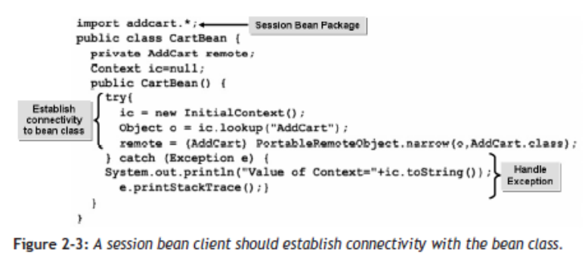
Session Bean Clients (1/2)
The client class should contain some vital components to be completely functional.
The class should first import the session bean package, where the bean classes reside.
Notes:
Instuctor notes:
The client class should contain some vital components to be completely functional.
The class should first import the session bean package, where the bean classes reside.
The client should then establish connectivity to the bean class.
Additionally, the session bean client should also implement exception handling for dealing with any exceptions that may arise when calling the bean’s methods.

Slide 45
Session Bean Clients (2/2)
The client should then establish connectivity to the bean class.
Additionally, the session bean client should also implement exception handling for dealing with any exceptions that may arise when calling the bean’s methods.
Notes:
Instuctor notes:
The client class should contain some vital components to be completely functional.
The class should first import the session bean package, where the bean classes reside.
The client should then establish connectivity to the bean class.
Additionally, the session bean client should also implement exception handling for dealing with any exceptions that may arise when calling the bean’s methods.

Slide 46
How to Create a Session Bean Client
Procedure Reference: Create a Session Bean Client
To create a session bean client:
Create an intermediary bean class that imports the necessary classes and packages to implement the session bean’s functionality.
Add a constructor that creates an initial context and assigns its reference to the remote variables.
In the intermediary bean, define the business methods that respond to calls from the client web page and contain calls to the EJB class business methods.
Save and compile the bean file.
In a client JSP, add code that imports and instantiates the intermediary bean and sets its properties.
In the JSP, add calls to the bean’s methods.
Notes:
Instuctor notes:
Procedure Reference: Create a Session Bean Client
To create a session bean client:
1. Create an intermediary bean class that imports the necessary classes and packages
to implement the session bean’s functionality.
2. Add a constructor that creates an initial context and assigns its reference to the
remote variables.
3. In the intermediary bean, define the business methods that respond to calls from
the client web page and contain calls to the EJB class business methods.
4. Save and compile the bean file.
5. In a client JSP, add code that imports and instantiates the intermediary bean and
sets its properties.
6. In the JSP, add calls to the bean’s methods.

Slide 47
How to Create a Session Bean Client
JSP Tags for Using EJBs
There are some JSP tags that are used to import and manipulate an intermediary bean and the EJB that it represents.
Notes:
Instuctor notes:
Procedure Reference: Create a Session Bean Client
To create a session bean client:
1. Create an intermediary bean class that imports the necessary classes and packages
to implement the session bean’s functionality.
2. Add a constructor that creates an initial context and assigns its reference to the
remote variables.
3. In the intermediary bean, define the business methods that respond to calls from
the client web page and contain calls to the EJB class business methods.
4. Save and compile the bean file.
5. In a client JSP, add code that imports and instantiates the intermediary bean and
sets its properties.
6. In the JSP, add calls to the bean’s methods.

Slide 48
How to Create a Session Bean Client
JSP Tag | Description
<%@page import = BeanName %> | Provides directive for importing the given bean as the JSP is compiled.
<jsp:useBean id=BeanID scope = session class=BeanClassName /> | Instantiates a bean with the given class name and stores a reference to the bean in the id reference. The bean’s scope can be session, page, request, or application.
<jsp:getProperty name=BeanID property=BeanProperty /> | Uses the bean’s getter methods to retrieve a class member’s value.
<jsp:setProperty name=BeanID property =BeanPropertyName value=NewValue /> | Uses the bean’s setter methods to set a class member’s value.
Notes:
Instuctor notes:
Procedure Reference: Create a Session Bean Client
To create a session bean client:
1. Create an intermediary bean class that imports the necessary classes and packages
to implement the session bean’s functionality.
2. Add a constructor that creates an initial context and assigns its reference to the
remote variables.
3. In the intermediary bean, define the business methods that respond to calls from
the client web page and contain calls to the EJB class business methods.
4. Save and compile the bean file.
5. In a client JSP, add code that imports and instantiates the intermediary bean and
sets its properties.
6. In the JSP, add calls to the bean’s methods.

Slide 49
Activity 2-4
Activity Time: 10 minutes
Data Files:
  CartBean.java
  AddCart.jsp
  Checkout.jsp
Before You Begin:
From C:\085593Data\Developing Session Beans\Activity 4\Starter\CartClient\WEB-INF\classes\mycart, open CartBean.java.
Open a command prompt window and navigate to C:\085593Data\Developing Session Beans\Activity 4\Starter\CartClient\WEB-INF\classes.
Notes:
Instuctor notes:
Activity Time:
10 minutes
Data Files:
• CartBean.java
• AddCart.jsp
• Checkout.jsp
Before You Begin:
1. From C:\085593Data\Developing Session Beans\Activity 4\Starter\CartClient\WEB-INF\
classes\mycart, open CartBean.java.
2. Open a command prompt window and navigate to C:\085593Data\Developing Session
Beans\Activity 4\Starter\CartClient\WEB-INF\classes.

Slide 50
Activity 2-4
Scenario:
The customers of Pearl & Company’s website need an easy way to browse the online catalog, add items to their carts, and view the contents of their carts.
To achieve this, a representative from Pearl & Company has provided you with a sample web page that displays the contents of the catalog (AddCart.jsp) and a page that displays the contents of a customer’s shopping cart (Checkout.jsp).
The AddCart.jsp web page displays a button for each item in the catalog.
When a user clicks these buttons, the item’s details are appended to the URL string as parameters.
Notes:
Instuctor notes:
Activity Time:
10 minutes
Data Files:
• CartBean.java
• AddCart.jsp
• Checkout.jsp
Before You Begin:
1. From C:\085593Data\Developing Session Beans\Activity 4\Starter\CartClient\WEB-INF\
classes\mycart, open CartBean.java.
2. Open a command prompt window and navigate to C:\085593Data\Developing Session
Beans\Activity 4\Starter\CartClient\WEB-INF\classes.

Slide 51
Activity 2-4
Scenario:
Your application plan specifies that your shopping cart session bean will parse and store these parameters. In addition, your application plan specifies that the Checkout.jsp web page will display the contents of the shopping cart.
In order to complete the Shopping Cart application, you will create an intermediary bean class that enables the web pages to interact with the CartEJB, insert code into the AddCart.jsp page that adds items to the CartEJB, and insert code into the Checkout.jsp page that displays the contents of the shopping cart bean.
Notes:
Instuctor notes:
Activity Time:
10 minutes
Data Files:
• CartBean.java
• AddCart.jsp
• Checkout.jsp
Before You Begin:
1. From C:\085593Data\Developing Session Beans\Activity 4\Starter\CartClient\WEB-INF\
classes\mycart, open CartBean.java.
2. Open a command prompt window and navigate to C:\085593Data\Developing Session
Beans\Activity 4\Starter\CartClient\WEB-INF\classes.

Slide 52
Activity 2-4
What You Do | How You Do It
1. Create an intermediary bean class that imports the necessary classes and packages to implement the session bean’s functionality and that contains a constructor that creates a naming context for the bean. | a. In CartBean.java, verify that javax.naming.*, java.util.Enumeration, javax.rmi.PortableRemoteObject, java.io.*, java.util.Properties, and addcart.* packages are imported. b. Within the try block of the CartBean() constructor, create an initial context and assign its reference to the remote variable. See Code Sample 1.
Notes:
Instuctor notes:
What You Do How You Do It
1. Create an intermediary bean class
that imports the necessary classes
and packages to implement the session
bean’s functionality and that
contains a constructor that creates
a naming context for the bean.
a. In CartBean.java, verify that
javax.naming.*,
java.util.Enumeration,
javax.rmi.PortableRemoteObject,
java.io.*, java.util.Properties,
and addcart.* packages are imported.
b. Within the try block of the CartBean()
constructor, create an initial context and
assign its reference to the remote variable.
See Code Sample 1.
Code Sample 1
ic = new InitialContext();
Object o = ic.lookup("AddCart");
remote = (AddCart) PortableRemoteObject.narrow(o,AddCart.class);

Slide 53
Activity 2-4
Code Sample 1
ic = new InitialContext();
Object o = ic.lookup("AddCart");
remote = (AddCart) PortableRemoteObject.narrow(o,AddCart.class);
Go back
Notes:
Instuctor notes:
What You Do How You Do It
1. Create an intermediary bean class
that imports the necessary classes
and packages to implement the session
bean’s functionality and that
contains a constructor that creates
a naming context for the bean.
a. In CartBean.java, verify that
javax.naming.*,
java.util.Enumeration,
javax.rmi.PortableRemoteObject,
java.io.*, java.util.Properties,
and addcart.* packages are imported.
b. Within the try block of the CartBean()
constructor, create an initial context and
assign its reference to the remote variable.
See Code Sample 1.
Code Sample 1
ic = new InitialContext();
Object o = ic.lookup("AddCart");
remote = (AddCart) PortableRemoteObject.narrow(o,AddCart.class);

Slide 54
Activity 2-4
What You Do | How You Do It
2. In the intermediary bean, define the business methods that respond to calls from the web page and contain calls to the EJB class. | a. In the if loop, click after return; and press Enter. b. Type CartItem item = new CartItem(c,s, Double.parseDouble(p), Integer.parseInt(q) ); to create a CartItem from the method parameters. c. In the try block of the addToCart() method, click after the opening braces of the try block and press Enter.
Notes:
Instuctor notes:
2. In the intermediary bean, define the
business methods that respond to
calls from the web page and contain
calls to the EJB class.
a. In the if loop, click after return; and
press Enter.
b. Type
CartItem item = new CartItem(c,s,
Double.parseDouble(p),
Integer.parseInt(q) );
to create a CartItem from the method
parameters.
c. In the try block of the addToCart()
method, click after the opening braces
of the try block and press Enter.
d. Type
remote.addToCart(item);
to call the EJB’s addToCart() method,
passing it the CartItem.
e. Scroll down to view the getCart()
method.
f. In the try block of the getCart()
method, click after the opening braces
and press Enter.
g. Type
cart = remote.getCart().elements()
;
to initialize the cart enumeration by having
the elements returned by the EJB’s
getCart() method.
h. In the try block of the getCount()
method, click after the opening braces
and press Enter.
i. Type
return remote.getCount();
to add a call to the remote getCount()
method, and return the resulting value.
j. Save and close the file.
LESSON 2
40 EJB3.0

Slide 55
Activity 2-4
What You Do | How You Do It
2. In the intermediary bean, define the business methods that respond to calls from the web page and contain calls to the EJB class. | d. Type remote.addToCart(item); to call the EJB’s addToCart() method, passing it the CartItem. e. Scroll down to view the getCart() method. f. In the try block of the getCart() method, click after the opening braces and press Enter.
Notes:
Instuctor notes:
2. In the intermediary bean, define the
business methods that respond to
calls from the web page and contain
calls to the EJB class.
a. In the if loop, click after return; and
press Enter.
b. Type
CartItem item = new CartItem(c,s,
Double.parseDouble(p),
Integer.parseInt(q) );
to create a CartItem from the method
parameters.
c. In the try block of the addToCart()
method, click after the opening braces
of the try block and press Enter.
d. Type
remote.addToCart(item);
to call the EJB’s addToCart() method,
passing it the CartItem.
e. Scroll down to view the getCart()
method.
f. In the try block of the getCart()
method, click after the opening braces
and press Enter.
g. Type
cart = remote.getCart().elements()
;
to initialize the cart enumeration by having
the elements returned by the EJB’s
getCart() method.
h. In the try block of the getCount()
method, click after the opening braces
and press Enter.
i. Type
return remote.getCount();
to add a call to the remote getCount()
method, and return the resulting value.
j. Save and close the file.
LESSON 2
40 EJB3.0

Slide 56
Activity 2-4
What You Do | How You Do It
2. In the intermediary bean, define the business methods that respond to calls from the web page and contain calls to the EJB class. | g. Type cart = remote.getCart().elements() ; to initialize the cart enumeration by having the elements returned by the EJB’s getCart() method. h. In the try block of the getCount() method, click after the opening braces and press Enter.
Notes:
Instuctor notes:
2. In the intermediary bean, define the
business methods that respond to
calls from the web page and contain
calls to the EJB class.
a. In the if loop, click after return; and
press Enter.
b. Type
CartItem item = new CartItem(c,s,
Double.parseDouble(p),
Integer.parseInt(q) );
to create a CartItem from the method
parameters.
c. In the try block of the addToCart()
method, click after the opening braces
of the try block and press Enter.
d. Type
remote.addToCart(item);
to call the EJB’s addToCart() method,
passing it the CartItem.
e. Scroll down to view the getCart()
method.
f. In the try block of the getCart()
method, click after the opening braces
and press Enter.
g. Type
cart = remote.getCart().elements()
;
to initialize the cart enumeration by having
the elements returned by the EJB’s
getCart() method.
h. In the try block of the getCount()
method, click after the opening braces
and press Enter.
i. Type
return remote.getCount();
to add a call to the remote getCount()
method, and return the resulting value.
j. Save and close the file.
LESSON 2
40 EJB3.0

Slide 57
Activity 2-4
What You Do | How You Do It
2. In the intermediary bean, define the business methods that respond to calls from the web page and contain calls to the EJB class. | i. Type return remote.getCount(); to add a call to the remote getCount() method, and return the resulting value. j. Save and close the file.
Notes:
Instuctor notes:
2. In the intermediary bean, define the
business methods that respond to
calls from the web page and contain
calls to the EJB class.
a. In the if loop, click after return; and
press Enter.
b. Type
CartItem item = new CartItem(c,s,
Double.parseDouble(p),
Integer.parseInt(q) );
to create a CartItem from the method
parameters.
c. In the try block of the addToCart()
method, click after the opening braces
of the try block and press Enter.
d. Type
remote.addToCart(item);
to call the EJB’s addToCart() method,
passing it the CartItem.
e. Scroll down to view the getCart()
method.
f. In the try block of the getCart()
method, click after the opening braces
and press Enter.
g. Type
cart = remote.getCart().elements()
;
to initialize the cart enumeration by having
the elements returned by the EJB’s
getCart() method.
h. In the try block of the getCount()
method, click after the opening braces
and press Enter.
i. Type
return remote.getCount();
to add a call to the remote getCount()
method, and return the resulting value.
j. Save and close the file.
LESSON 2
40 EJB3.0

Slide 58
Activity 2-4
What You Do | How You Do It
3. Compile the CartBean.java file. | a. Switch to the command prompt window. b. Type set classpath=%classpath%; C:\085593Data\Developing Session Beans\Activity4\Starter\stateful;.; and press Enter to set the classpath. c. Type javac mycart\CartBean.java and press Enter to compile the CartBean.java file.
Notes:
Instuctor notes:
3. Compile the CartBean.java file. a. Switch to the command prompt window.
b. Type
set classpath=%classpath%;
C:\085593Data\Developing Session
Beans\Activity
4\Starter\stateful;.;
and press Enter to set the classpath.
c. Type
javac mycart\CartBean.java
and press Enter to compile the
CartBean.java file.
d. Type
exit
and press Enter to exit the command
prompt window.

Slide 59
Activity 2-4
What You Do | How You Do It
3. Compile the CartBean.java file. | d. Type exit and press Enter to exit the command prompt window.
Notes:
Instuctor notes:
3. Compile the CartBean.java file. a. Switch to the command prompt window.
b. Type
set classpath=%classpath%;
C:\085593Data\Developing Session
Beans\Activity
4\Starter\stateful;.;
and press Enter to set the classpath.
c. Type
javac mycart\CartBean.java
and press Enter to compile the
CartBean.java file.
d. Type
exit
and press Enter to exit the command
prompt window.

Slide 60
Activity 2-4
What You Do | How You Do It
4. Set the bean’s ID to CartBean, the bean’s scope to session, and its class to CartBean. | a. From C:\085593Data\Developing Session Beans\Activity 4\Starter\CartClient, open AddCart.jsp. b. Click after <title>Online Shopping </title> and press Enter. c. Type <jsp:useBean id="CartBean" scope ="session" class= "mycart.CartBean"/> and press Enter to set the bean’s ID to CartBean, the bean’s scope to session, and its class to CartBean.
Notes:
Instuctor notes:
4. Set the bean’s ID to CartBean, the
bean’s scope to session, and its
class to CartBean.
a. From C:\085593Data\Developing Session
Beans\Activity 4\Starter\CartClient, open
AddCart.jsp.
b. Click after <title>Online Shopping
</title> and press Enter.
c. Type
<jsp:useBean id="CartBean" scope=
"session" class=
"mycart.CartBean"/>
and press Enter to set the bean’s ID to
CartBean, the bean’s scope to session,
and its class to CartBean.

Slide 61
Activity 2-4
What You Do | How You Do It
5. Collect the prod_code, prod_name, and prod_price parameters from the URL string, and call the bean’smaddToCart() method with these parameters. | a. Add code to collect the prod_code, prod_name, and prod_price parameters from the URL string, and call the bean’s addToCart() method with these parameters. See Code Sample 2. b. Save and close the file.
Code Sample 2 <% out.println("Cart Bean=" + CartBean.toString()); CartBean.addToCart(request.getParameter("prodCode"), request.getParameter⇒ ("prodName"), request.getParameter("price"), request.getParameter("quantity"));%>
Notes:
Instuctor notes:
5. Collect the prod_code, prod_name,
and prod_price parameters from
the URL string, and call the bean’s
addToCart() method with these
parameters.
a. Add code to collect the prod_code,
prod_name, and prod_price parameters
from the URL string, and call the
bean’s addToCart() method with these
parameters.
See Code Sample 2.
b. Save and close the file.
Code Sample 2
<%
out.println("Cart Bean=" + CartBean.toString());
CartBean.addToCart(request.getParameter("prodCode"), request.getParameter⇒
("prodName"), request.getParameter("price"), request.getParameter("quantity"));%>

Slide 62
Activity 2-4
What You Do | How You Do It
6. Add a call to the getCart() method. | a. From C:\085593Data\Developing ession Beans\Activity 4\Starter\CartClient, open Checkout.jsp. b. In the getCart() method, click after <% and press Enter. c. Type CartBean.getCart(); to call the bean’s getCart() method and display the contents of the cart. d. Save and close the file.
Notes:
Instuctor notes:
6. Add a call to the getCart()
method.
a. From C:\085593Data\Developing Session
Beans\Activity 4\Starter\CartClient, open
Checkout.jsp.
b. In the getCart() method, click after <%
and press Enter.
c. Type
CartBean.getCart();
to call the bean’s getCart() method
and display the contents of the cart.
d. Save and close the file.

Slide 63
Topic E
Deploy a Session Bean Component
You have created a session bean and a client for the session bean. You now need to integrate the various EJB components and prepare them for deployment and execution.
In this topic, you will deploy the session bean component onto the server and test its functionality.
Session beans that have been created should be deployed onto a server in order to perform a particular functionality. Deploying the EJBs to a container for processing allows for an efficient usage of EJB components and provides the required operability.
Notes:
Instuctor notes:
You have created a session bean and a client for the session bean. You now need to integrate the various EJB components and prepare them for deployment and execution.
In this topic, you will deploy the session bean component onto the server and test its functionality.
Session beans that have been created should be deployed onto a server in order to perform a particular functionality. Deploying the EJBs to a container for processing allows for an efficient usage of EJB components and provides the required operability.

Slide 64
Pack an EJB
Once EJBs have been created, the corresponding .java files must be compiled. The compiled files possess the .class file extension. Depending on the nature of the class files, and their associated package, these files must be archived further.
Archive Type | Description
JAR | Java Archive—A compilation of bean classes.
WAR | Web Archive—A compilation of client-side components.
EAR | Enterprise Archive—A compilation of JAR and WAR files.
JAR vs. WAR
A Web Archive (WAR) contains the web components like servlets, JSPs, and JSP tag libraries. Conversely, a JAR contains only EJB components.
Notes:
Instuctor notes:
Once EJBs have been created, the corresponding .java files must be compiled. The compiled
files possess the .class file extension. Depending on the nature of the class files, and their associated
package, these files must be archived further.
Archive Type Description
JAR Java Archive—A compilation of bean classes.
WAR Web Archive—A compilation of client-side components.
EAR Enterprise Archive—A compilation of JAR and
WAR files.
JAR vs. WAR
A Web Archive (WAR) contains the web components like servlets, JSPs, and JSP tag
libraries. Conversely, a JAR contains only EJB components.

Slide 65
Deployment
The archive files that you create should be placed in the deploy folder of the JBoss server.
The folder is usually present in JBoss\server\default\deploy directory structure.
The folder contains the enterprise application files to be executed.
Run the server to deploy the application after placing the archive files.
Notes:
Instuctor notes:
Once EJBs have been created, the corresponding .java files must be compiled. The compiled
files possess the .class file extension. Depending on the nature of the class files, and their associated
package, these files must be archived further.
Archive Type Description
JAR Java Archive—A compilation of bean classes.
WAR Web Archive—A compilation of client-side components.
EAR Enterprise Archive—A compilation of JAR and
WAR files.
JAR vs. WAR
A Web Archive (WAR) contains the web components like servlets, JSPs, and JSP tag
libraries. Conversely, a JAR contains only EJB components.

Slide 66

Stub and Skeleton Communication
The stub and skeleton are objects on a client and server, respectively.
They are also components of the internal Java architecture and cannot be explicitly accessed and managed.
The data that needs to be shared is sent to the stub, where it is marshalled and sent over the network to the server.
The skeleton on the server unmarshalls the data and processes it.
The resultant data is then marshalled at the skeleton and sent to the stub for unmarshalling and delivering to the client.
Marshalling data secures it from any unauthorized access or hacking during a transaction.
Notes:
Instuctor notes:
The stub and skeleton are objects on a client and server, respectively. They are also components
of the internal Java architecture and cannot be explicitly accessed and managed. The data
that needs to be shared is sent to the stub, where it is marshalled and sent over the network to
the server.
The skeleton on the server unmarshalls the data and processes it. The resultant data is then
marshalled at the skeleton and sent to the stub for unmarshalling and delivering to the client.
Marshalling data secures it from any unauthorized access or hacking during a transaction.

Slide 67
How to Deploy a Session Bean Component
Procedure Reference: Deploy a Session Bean Component
To deploy a session bean component:
At the command prompt, type jar cvf JAR file name class name\*.class XML name\*.xml to package the JAR file.
Type jar cvf WAR file name * to package the WAR file.
Type jar cvf EAR file name WAR file name JAR file name XML name\*.xml to package the EAR file.
Copy the EAR file, and paste it in the deploy folder.
Deploy the application to check if the stateful session bean component is deployed successfully.
Test the application.
Archive Type Abbreviations
In the syntax for the archive files, the term “cvf” stands for:
  c: Create new archive
  v: Generate verbose output on standard output
  f: Specify archive file name
Notes:
Instuctor notes:
Procedure Reference: Deploy a Session Bean Component
To deploy a session bean component:
1. At the command prompt, type jar cvf JAR file name class
name\*.class XML name\*.xml to package the JAR file.
2. Type jar cvf WAR file name * to package the WAR file.
3. Type jar cvf EAR file name WAR file name JAR file name
XML name\*.xml to package the EAR file.
4. Copy the EAR file, and paste it in the deploy folder.
5. Deploy the application to check if the stateful session bean component is
deployed successfully.
6. Test the application.
Archive Type Abbreviations
In the syntax for the archive files, the term “cvf” stands for:
• c: Create new archive
• v: Generate verbose output on standard output
• f: Specify archive file name

Slide 68
Activity 2-5
Activity Time: 5 minutes
Before You Begin: Open a command prompt window and navigate to C:\085593Data\Developing Session Beans\Activity 5\Starter\stateful.
Scenario:
You have now completed the server and client parts of the Shopping Cart module.
To give Pearl & Company a feel of what the module will look like, the Shopping Cart module has to be deployed on the server.
Notes:
Instuctor notes:
Procedure Reference: Deploy a Session Bean Component
To deploy a session bean component:
1. At the command prompt, type jar cvf JAR file name class
name\*.class XML name\*.xml to package the JAR file.
2. Type jar cvf WAR file name * to package the WAR file.
3. Type jar cvf EAR file name WAR file name JAR file name
XML name\*.xml to package the EAR file.
4. Copy the EAR file, and paste it in the deploy folder.
5. Deploy the application to check if the stateful session bean component is
deployed successfully.
6. Test the application.
Archive Type Abbreviations
In the syntax for the archive files, the term “cvf” stands for:
• c: Create new archive
• v: Generate verbose output on standard output
• f: Specify archive file name

Slide 69
Activity 2-5
What You Do | How You Do It
1. Create an enterprise application for the stateful bean. | a. At the command prompt, type jar cvf cartEjb.jar addcart\*.class META-INF\*.xml and press Enter to create the cartEjb.jar file. b. From C:\085593Data\Developing SessionBeans\Activity 5\Starter\stateful, copy cartEjb.jar, and paste it in C:\085593Data\Developing Session Beans\Activity 5\Starter. c. At the command prompt, type cd.. and press Enter.
Notes:
Instuctor notes:
What You Do How You Do It
1. Create an enterprise application for
the stateful bean.
a. At the command prompt, type
jar cvf cartEjb.jar
addcart\*.class META-INF\*.xml
and press Enter to create the cartEjb.jar
file.
b. From C:\085593Data\Developing Session
Beans\Activity 5\Starter\stateful, copy
cartEjb.jar, and paste it in C:\
085593Data\Developing Session Beans\
Activity 5\Starter.
c. At the command prompt, type
cd..
and press Enter.
d. Type
cd CartClient
and press Enter.
e. Type
jar cvf cartweb.war *
and press Enter to create the
cartweb.war file for the CartClient.
f. From C:\085593Data\Developing Session
Beans\Activity 5\Starter\CartClient, copy
the cartweb.war file, and paste it in C:\
085593Data\Developing Session Beans\
Activity 5\Starter.
g. At the command prompt, type
cd..
and press Enter.
h. Type
jar cvf AddCart.ear cartEjb.jar
cartweb.war META-INF\*.xml
and press Enter to create the
AddCart.ear file.
i. From C:\085593Data\Developing Session
Beans\Activity 5\Starter, copy
AddCart.ear and paste it in C:\JBoss\
jboss-4.0.3SP1\server\default\deploy.
j. Type
Learning & Knowledge - IBMIndia LESSON 2
Lesson 2: Developing Session Beans 45
exit
and press Enter to exit the command
prompt window.
k. Open a new command prompt window.
l. At the command prompt, type
cd C:\JBoss\jboss-4.0.3SP1\bin
and press Enter to navigate to the bin
folder.
m. At the command prompt, type
run
and press Enter to run the server.
n. Observe that the stateful session bean
component is deployed successfully.
o. Minimize the command prompt window.

Slide 70
Activity 2-5
What You Do | How You Do It
1. Create an enterprise application for the stateful bean. | d. Type cd CartClient and press Enter. e. Type jar cvf cartweb.war * and press Enter to create the cartweb.war file for the CartClient. f. From C:\085593Data\Developing SessionBeans\Activity5\Starter\CartClient, copy the cartweb.war file, and paste it in C:\085593Data\Developing Session Beans\Activity 5\Starter.
Notes:
Instuctor notes:
What You Do How You Do It
1. Create an enterprise application for
the stateful bean.
a. At the command prompt, type
jar cvf cartEjb.jar
addcart\*.class META-INF\*.xml
and press Enter to create the cartEjb.jar
file.
b. From C:\085593Data\Developing Session
Beans\Activity 5\Starter\stateful, copy
cartEjb.jar, and paste it in C:\
085593Data\Developing Session Beans\
Activity 5\Starter.
c. At the command prompt, type
cd..
and press Enter.
d. Type
cd CartClient
and press Enter.
e. Type
jar cvf cartweb.war *
and press Enter to create the
cartweb.war file for the CartClient.
f. From C:\085593Data\Developing Session
Beans\Activity 5\Starter\CartClient, copy
the cartweb.war file, and paste it in C:\
085593Data\Developing Session Beans\
Activity 5\Starter.
g. At the command prompt, type
cd..
and press Enter.
h. Type
jar cvf AddCart.ear cartEjb.jar
cartweb.war META-INF\*.xml
and press Enter to create the
AddCart.ear file.
i. From C:\085593Data\Developing Session
Beans\Activity 5\Starter, copy
AddCart.ear and paste it in C:\JBoss\
jboss-4.0.3SP1\server\default\deploy.
j. Type
Learning & Knowledge - IBMIndia LESSON 2
Lesson 2: Developing Session Beans 45
exit
and press Enter to exit the command
prompt window.
k. Open a new command prompt window.
l. At the command prompt, type
cd C:\JBoss\jboss-4.0.3SP1\bin
and press Enter to navigate to the bin
folder.
m. At the command prompt, type
run
and press Enter to run the server.
n. Observe that the stateful session bean
component is deployed successfully.
o. Minimize the command prompt window.

Slide 71
Activity 2-5
What You Do | How You Do It
1. Create an enterprise application for the stateful bean. | g. At the command prompt, type cd.. and press Enter. h. Type jar cvf AddCart.ear cartEjb.jar cartweb.war META-INF\*.xml and press Enter to create the AddCart.ear file. i. From C:\085593Data\Developing Session Beans\Activity 5\Starter, copy AddCart.ear and paste it in C:\JBoss\jboss-4.0.3SP1\server\default\deploy.
Notes:
Instuctor notes:
What You Do How You Do It
1. Create an enterprise application for
the stateful bean.
a. At the command prompt, type
jar cvf cartEjb.jar
addcart\*.class META-INF\*.xml
and press Enter to create the cartEjb.jar
file.
b. From C:\085593Data\Developing Session
Beans\Activity 5\Starter\stateful, copy
cartEjb.jar, and paste it in C:\
085593Data\Developing Session Beans\
Activity 5\Starter.
c. At the command prompt, type
cd..
and press Enter.
d. Type
cd CartClient
and press Enter.
e. Type
jar cvf cartweb.war *
and press Enter to create the
cartweb.war file for the CartClient.
f. From C:\085593Data\Developing Session
Beans\Activity 5\Starter\CartClient, copy
the cartweb.war file, and paste it in C:\
085593Data\Developing Session Beans\
Activity 5\Starter.
g. At the command prompt, type
cd..
and press Enter.
h. Type
jar cvf AddCart.ear cartEjb.jar
cartweb.war META-INF\*.xml
and press Enter to create the
AddCart.ear file.
i. From C:\085593Data\Developing Session
Beans\Activity 5\Starter, copy
AddCart.ear and paste it in C:\JBoss\
jboss-4.0.3SP1\server\default\deploy.
j. Type
Learning & Knowledge - IBMIndia LESSON 2
Lesson 2: Developing Session Beans 45
exit
and press Enter to exit the command
prompt window.
k. Open a new command prompt window.
l. At the command prompt, type
cd C:\JBoss\jboss-4.0.3SP1\bin
and press Enter to navigate to the bin
folder.
m. At the command prompt, type
run
and press Enter to run the server.
n. Observe that the stateful session bean
component is deployed successfully.
o. Minimize the command prompt window.

Slide 72
Activity 2-5
What You Do | How You Do It
1. Create an enterprise application for the stateful bean. | j. Type exit and press Enter to exit the command prompt window. k. Open a new command prompt window. l. At the command prompt, type cd C:\JBoss\jboss-4.0.3SP1\bin and press Enter to navigate to the bin folder.
Notes:
Instuctor notes:
What You Do How You Do It
1. Create an enterprise application for
the stateful bean.
a. At the command prompt, type
jar cvf cartEjb.jar
addcart\*.class META-INF\*.xml
and press Enter to create the cartEjb.jar
file.
b. From C:\085593Data\Developing Session
Beans\Activity 5\Starter\stateful, copy
cartEjb.jar, and paste it in C:\
085593Data\Developing Session Beans\
Activity 5\Starter.
c. At the command prompt, type
cd..
and press Enter.
d. Type
cd CartClient
and press Enter.
e. Type
jar cvf cartweb.war *
and press Enter to create the
cartweb.war file for the CartClient.
f. From C:\085593Data\Developing Session
Beans\Activity 5\Starter\CartClient, copy
the cartweb.war file, and paste it in C:\
085593Data\Developing Session Beans\
Activity 5\Starter.
g. At the command prompt, type
cd..
and press Enter.
h. Type
jar cvf AddCart.ear cartEjb.jar
cartweb.war META-INF\*.xml
and press Enter to create the
AddCart.ear file.
i. From C:\085593Data\Developing Session
Beans\Activity 5\Starter, copy
AddCart.ear and paste it in C:\JBoss\
jboss-4.0.3SP1\server\default\deploy.
j. Type
Learning & Knowledge - IBMIndia LESSON 2
Lesson 2: Developing Session Beans 45
exit
and press Enter to exit the command
prompt window.
k. Open a new command prompt window.
l. At the command prompt, type
cd C:\JBoss\jboss-4.0.3SP1\bin
and press Enter to navigate to the bin
folder.
m. At the command prompt, type
run
and press Enter to run the server.
n. Observe that the stateful session bean
component is deployed successfully.
o. Minimize the command prompt window.

Slide 73
Activity 2-5
What You Do | How You Do It
1. Create an enterprise application for the stateful bean. | m. At the command prompt, type run and press Enter to run the server. n. Observe that the stateful session bean component is deployed successfully. o. Minimize the command prompt window.
Notes:
Instuctor notes:
What You Do How You Do It
1. Create an enterprise application for
the stateful bean.
a. At the command prompt, type
jar cvf cartEjb.jar
addcart\*.class META-INF\*.xml
and press Enter to create the cartEjb.jar
file.
b. From C:\085593Data\Developing Session
Beans\Activity 5\Starter\stateful, copy
cartEjb.jar, and paste it in C:\
085593Data\Developing Session Beans\
Activity 5\Starter.
c. At the command prompt, type
cd..
and press Enter.
d. Type
cd CartClient
and press Enter.
e. Type
jar cvf cartweb.war *
and press Enter to create the
cartweb.war file for the CartClient.
f. From C:\085593Data\Developing Session
Beans\Activity 5\Starter\CartClient, copy
the cartweb.war file, and paste it in C:\
085593Data\Developing Session Beans\
Activity 5\Starter.
g. At the command prompt, type
cd..
and press Enter.
h. Type
jar cvf AddCart.ear cartEjb.jar
cartweb.war META-INF\*.xml
and press Enter to create the
AddCart.ear file.
i. From C:\085593Data\Developing Session
Beans\Activity 5\Starter, copy
AddCart.ear and paste it in C:\JBoss\
jboss-4.0.3SP1\server\default\deploy.
j. Type
Learning & Knowledge - IBMIndia LESSON 2
Lesson 2: Developing Session Beans 45
exit
and press Enter to exit the command
prompt window.
k. Open a new command prompt window.
l. At the command prompt, type
cd C:\JBoss\jboss-4.0.3SP1\bin
and press Enter to navigate to the bin
folder.
m. At the command prompt, type
run
and press Enter to run the server.
n. Observe that the stateful session bean
component is deployed successfully.
o. Minimize the command prompt window.

Slide 74
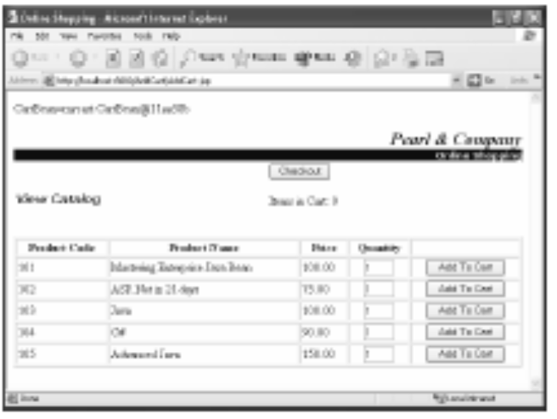
Activity 2-5
2. Run the application.
  a. Open Internet Explorer and navigate to
  http://localhost:8080/AddCart/
  AddCart.jsp.
  b. Add items to the Shopping Cart by clicking
  Add To Cart.
Notes:
Instuctor notes:
2. Run the application. a. Open Internet Explorer and navigate to
http://localhost:8080/AddCart/
AddCart.jsp.
b. Add items to the Shopping Cart by clicking
Add To Cart.

Slide 75
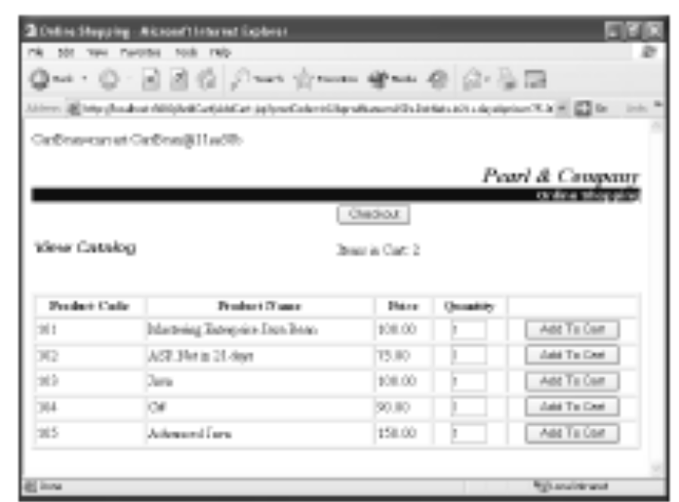
Activity 2-5
2. Run the application.
  c. Observe that the message “Items in Cart:
  2” is displayed.
  d. Click Checkout to display the contents of your Shopping Cart on the Checkout.jsp.
Notes:
Instuctor notes:
2. Run the application. a. Open Internet Explorer and navigate to
http://localhost:8080/AddCart/
AddCart.jsp.
b. Add items to the Shopping Cart by clicking
Add To Cart.

Slide 76
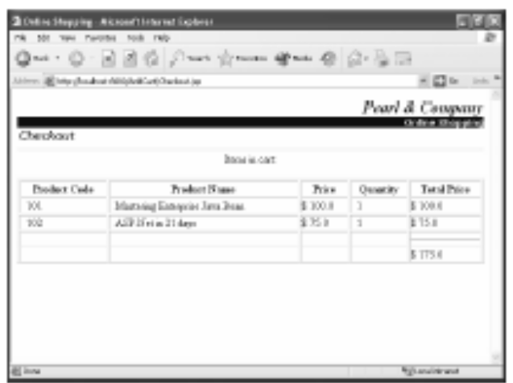
Activity 2-5
2. Run the application.
  e. Notice that the items added to the cart are displayed.
  f. Close the browser window.
  g. Switch to the command prompt window.
  h. At the command prompt, press Ctrl+C to stop the server.
  i. Type
  Y
  and press Enter to terminate the batch process.
Notes:
Instuctor notes:
2. Run the application. a. Open Internet Explorer and navigate to
http://localhost:8080/AddCart/
AddCart.jsp.
b. Add items to the Shopping Cart by clicking
Add To Cart.

Slide 77
Activity 2-5
2. Run the application.
  j. Type
  exit
  and press Enter to exit the command prompt window.
Notes:
Instuctor notes:
2. Run the application. a. Open Internet Explorer and navigate to
http://localhost:8080/AddCart/
AddCart.jsp.
b. Add items to the Shopping Cart by clicking
Add To Cart.

Slide 78
Topic F: Create a Stateless Session Bean
You have created and deployed a stateful session bean in a shopping cart application.
If you need multiple clients to access the database, you need to use stateless session beans.
In this topic, you’ll create and deploy a stateless session bean.
Stateful session beans persist in the EJB container, making it possible for them to perform tasks that span a user’s entire interaction with the server.
This feature comes at a cost, however, because of the server resources that are tied up in managing stateful session beans.
Stateless session beans, which are not persistent, can save server resources while providing services to a client.
Notes:
Instuctor notes:
You have created and deployed a stateful session bean in a shopping cart application. If you
need multiple clients to access the database, you need to use stateless session beans. In this
topic, you’ll create and deploy a stateless session bean.
Stateful session beans persist in the EJB container, making it possible for them to perform
tasks that span a user’s entire interaction with the server. This feature comes at a cost, however,
because of the server resources that are tied up in managing stateful session beans.
Stateless session beans, which are not persistent, can save server resources while providing
services to a client.

Slide 79
Stateless Session Beans
Stateless session beans have the same components with the same requirements as stateful session beans.
A stateless session bean is declared using the @Stateless annotation.
Unlike stateful session beans, stateless session beans can be used by more than one client, as stateless session beans are used to provide a one-time service to a client.
A stateless session bean provides better performance, because it is not persistent and doesn’t need to be written to secondary storage.
Notes:
Instuctor notes:
Stateless session beans have the same components with the same requirements as stateful session
beans. A stateless session bean is declared using the @Stateless annotation.
Unlike stateful session beans, stateless session beans can be used by more than one client, as
stateless session beans are used to provide a one-time service to a client. A stateless session
bean provides better performance, because it is not persistent and doesn’t need to be written to
secondary storage.

Slide 80
How to Create a Stateless Session Bean
Create an interface for the stateless session bean.
Declare a remote interface using the @Remote annotation.
Declare the business methods that the interface will implement.
Create the stateless EJB’s bean class, and import the required packages.
Declare a stateless session bean using the @Stateless annotation.
Bind the enterprise bean implementation class to the remote business interface.
Look up the data source to execute the query.
Create an intermediate bean file for JSP, and set up the initial context and look up the stateless session bean.
Notes:
Instuctor notes:
Procedure Reference: Create and Deploy a Stateless Session Bean
To create and deploy a stateless session bean:
1. Create an interface for the stateless session bean.
2. Declare a remote interface using the @Remote annotation.
3. Declare the business methods that the interface will implement.
4. Create the stateless EJB’s bean class, and import the required packages.
5. Declare a stateless session bean using the @Stateless annotation.
6. Bind the enterprise bean implementation class to the remote business interface.
7. Look up the data source to execute the query.
8. Create an intermediate bean file for JSP, and set up the initial context and look up
the stateless session bean.
9. In the intermediary bean, define the business methods that respond to calls from
the web page and contain calls to the EJB class.
10. In a client JSP, add code that imports and instantiates the intermediary bean and
sets the bean’s ID, scope, and class.
11. In the JSP, add calls to the bean’s methods.
12. Compile all the files.
13. Package the JAR, WAR, and EAR files.
14. Open the JBoss homepage, and open the Hypersonic Database manager.
15. Create and populate a table.
16. Deploy the application to check if the stateless session bean component is
deployed successfully.
17. Test the application.

Slide 81
How to Create a Stateless Session Bean
In the intermediary bean, define the business methods that respond to calls from the web page and contain calls to the EJB class.
In a client JSP, add code that imports and instantiates the intermediary bean and sets the bean’s ID, scope, and class.
In the JSP, add calls to the bean’s methods.
Compile all the files.
Package the JAR, WAR, and EAR files.
Open the JBoss homepage, and open the Hypersonic Database manager.
Create and populate a table.
Deploy the application to check if the stateless session bean component is deployed successfully.
Test the application.
Notes:
Instuctor notes:
Procedure Reference: Create and Deploy a Stateless Session Bean
To create and deploy a stateless session bean:
1. Create an interface for the stateless session bean.
2. Declare a remote interface using the @Remote annotation.
3. Declare the business methods that the interface will implement.
4. Create the stateless EJB’s bean class, and import the required packages.
5. Declare a stateless session bean using the @Stateless annotation.
6. Bind the enterprise bean implementation class to the remote business interface.
7. Look up the data source to execute the query.
8. Create an intermediate bean file for JSP, and set up the initial context and look up
the stateless session bean.
9. In the intermediary bean, define the business methods that respond to calls from
the web page and contain calls to the EJB class.
10. In a client JSP, add code that imports and instantiates the intermediary bean and
sets the bean’s ID, scope, and class.
11. In the JSP, add calls to the bean’s methods.
12. Compile all the files.
13. Package the JAR, WAR, and EAR files.
14. Open the JBoss homepage, and open the Hypersonic Database manager.
15. Create and populate a table.
16. Deploy the application to check if the stateless session bean component is
deployed successfully.
17. Test the application.

Slide 82
Activity 2-6
Activity Time: 20 minutes
Data Files:
  ProductViewer.java
  ProductViewerBean.java
  ProductListBean.java
  Cart2.jsp
  cartEjb.jar
Before You Begin:
  From C:\085593Data\Developing Session Beans\Activity6\Starter\stateless\pview, open ProductViewer.java.
  Open a command prompt window and navigate to C:\085593Data\Developing Session Beans\Activity 6\Starter.
Notes:
Instuctor notes:
Activity Time:
20 minutes
Data Files:
• ProductViewer.java
• ProductViewerBean.java
• ProductListBean.java
• Cart2.jsp
• cartEjb.jar
Before You Begin:
1. From C:\085593Data\Developing Session Beans\Activity 6\Starter\stateless\pview, open
ProductViewer.java.
2. Open a command prompt window and navigate to C:\085593Data\Developing Session
Beans\Activity 6\Starter.

Slide 83
Activity 2-6
Scenario:
You have completed the Shopping Cart module of the online shopping application.
According to the application plan, your client—Pearl & Company—will provide a database of its products that you will display in the catalog pages of the web client.
Users of the shopping application will be able to select products from the catalog pages to add to their shopping carts.
Your project lead wants you to create and deploy the stateless session bean class to display the contents of the product database on a web page.
Notes:
Instuctor notes:
Scenario:
You have completed the Shopping Cart module of the online shopping application. According
to the application plan, your client—Pearl & Company—will provide a database of its products
that you will display in the catalog pages of the web client. Users of the shopping application
will be able to select products from the catalog pages to add to their shopping carts. Your
project lead wants you to create and deploy the stateless session bean class to display the contents
of the product database on a web page.

Slide 84
Activity 2-6
What You Do | How You Do It
1. Import the packages that contain the methods you need to implement the functionality of the Shopping Cart module of your application, and create a remote interface called ProductViewer to collect the product list. | a. Import the java.util.ArrayList and javax.ejb.Remote packages. See Code Sample 1. b. Type @Remote and press Enter to declare a remote interface.
Code Sample 1 import java.util.ArrayList; import javax.ejb.Remote;
Notes:
Instuctor notes:
What You Do How You Do It
1. Import the packages that contain
the methods you need to implement
the functionality of the
Shopping Cart module of your application,
and create a remote
interface called ProductViewer to
collect the product list.
a. Import the java.util.ArrayList and
javax.ejb.Remote packages.
See Code Sample 1.
b. Type
@Remote
and press Enter to declare a remote
interface.
c. Declare the ProductViewer interface.
See Code Sample 2.
d. Within the ProductViewer interface
declaration, type
public ArrayList getProductList();
to declare the getProductList()
method of type ArrayList.
e. Save and close the file.
Code Sample 1
import java.util.ArrayList;
import javax.ejb.Remote;
Code Sample 2
public interface ProductViewer
{
}

Slide 85
Activity 2-6
What You Do | How You Do It
1. Import the packages that contain the methods you need to implement the functionality of the Shopping Cart module of your application, and create a remote interface called ProductViewer to collect the product list. | c. Declare the ProductViewer interface. See Code Sample 2. d. Within the ProductViewer interface declaration, type public ArrayList getProductList(); to declare the getProductList() method of type ArrayList. e. Save and close the file.
Code Sample 2 public interface ProductViewer { }
Notes:
Instuctor notes:
What You Do How You Do It
1. Import the packages that contain
the methods you need to implement
the functionality of the
Shopping Cart module of your application,
and create a remote
interface called ProductViewer to
collect the product list.
a. Import the java.util.ArrayList and
javax.ejb.Remote packages.
See Code Sample 1.
b. Type
@Remote
and press Enter to declare a remote
interface.
c. Declare the ProductViewer interface.
See Code Sample 2.
d. Within the ProductViewer interface
declaration, type
public ArrayList getProductList();
to declare the getProductList()
method of type ArrayList.
e. Save and close the file.
Code Sample 1
import java.util.ArrayList;
import javax.ejb.Remote;
Code Sample 2
public interface ProductViewer
{
}

Slide 86
Activity 2-6
What You Do | How You Do It
2. Implement an enterprise bean class of a stateless bean to return the product list from the database. | a. From C:\085593Data\Developing Session
Notes:
Instuctor notes:
2. Implement an enterprise bean class
of a stateless bean to return the
product list from the database.
a. From C:\085593Data\Developing Session
Beans\Activity 6\Starter\stateless\pview,
open ProductViewerBean.java.
b. Import the java.util.*,
javax.ejb.*, java.sql.*,
javax.annotation.*,
javax.sql.DataSource,
javax.naming.*,
javax.persistence.EntityManager,
javax.persistence.PersistenceContext,
and
org.jboss.annotation.ejb.RemoteBinding
packages.
See Code Sample 3.
c. Type @Stateless and press Enter to
declare the creation of a stateless session
bean.
d. Bind the enterprise bean implementation
class to the remote business
interface called ProductViewer.
See Code Sample 4.
e. Verify that a class called
ProductViewerBean that implements
the ProductViewer remote business
interface is declared.
Code Sample 3
import java.util.*;
import javax.ejb.*;
import java.sql.*;
import javax.annotation.*;
import javax.sql.DataSource;
import javax.naming.*;
import javax.persistence.EntityManager;
import javax.persistence.PersistenceContext;
import org.jboss.annotation.ejb.RemoteBinding;
Code Sample 4
@RemoteBinding
(jndiBinding="ProductViewer")

Slide 87
Activity 2-6
What You Do | How You Do It
2. Implement an enterprise bean class of a stateless bean to return the product list from the database. | b. Import the java.util.*, javax.ejb.*, java.sql.*, javax.annotation.*, javax.sql.DataSource, javax.naming.*, javax.persistence.EntityManager, javax.persistence.PersistenceContext, and org.jboss.annotation.ejb.RemoteBinding packages. See Code Sample 3.
Notes:
Instuctor notes:
2. Implement an enterprise bean class
of a stateless bean to return the
product list from the database.
a. From C:\085593Data\Developing Session
Beans\Activity 6\Starter\stateless\pview,
open ProductViewerBean.java.
b. Import the java.util.*,
javax.ejb.*, java.sql.*,
javax.annotation.*,
javax.sql.DataSource,
javax.naming.*,
javax.persistence.EntityManager,
javax.persistence.PersistenceContext,
and
org.jboss.annotation.ejb.RemoteBinding
packages.
See Code Sample 3.
c. Type @Stateless and press Enter to
declare the creation of a stateless session
bean.
d. Bind the enterprise bean implementation
class to the remote business
interface called ProductViewer.
See Code Sample 4.
e. Verify that a class called
ProductViewerBean that implements
the ProductViewer remote business
interface is declared.
Code Sample 3
import java.util.*;
import javax.ejb.*;
import java.sql.*;
import javax.annotation.*;
import javax.sql.DataSource;
import javax.naming.*;
import javax.persistence.EntityManager;
import javax.persistence.PersistenceContext;
import org.jboss.annotation.ejb.RemoteBinding;
Code Sample 4
@RemoteBinding
(jndiBinding="ProductViewer")

Slide 88
Activity 2-6
Code Sample 3
import java.util.*;
import javax.ejb.*;
import java.sql.*;
import javax.annotation.*;
import javax.sql.DataSource;
import javax.naming.*;
import javax.persistence.EntityManager;
import javax.persistence.PersistenceContext;
import org.jboss.annotation.ejb.RemoteBinding;
Go back
Notes:
Instuctor notes:
2. Implement an enterprise bean class
of a stateless bean to return the
product list from the database.
a. From C:\085593Data\Developing Session
Beans\Activity 6\Starter\stateless\pview,
open ProductViewerBean.java.
b. Import the java.util.*,
javax.ejb.*, java.sql.*,
javax.annotation.*,
javax.sql.DataSource,
javax.naming.*,
javax.persistence.EntityManager,
javax.persistence.PersistenceContext,
and
org.jboss.annotation.ejb.RemoteBinding
packages.
See Code Sample 3.
c. Type @Stateless and press Enter to
declare the creation of a stateless session
bean.
d. Bind the enterprise bean implementation
class to the remote business
interface called ProductViewer.
See Code Sample 4.
e. Verify that a class called
ProductViewerBean that implements
the ProductViewer remote business
interface is declared.
Code Sample 3
import java.util.*;
import javax.ejb.*;
import java.sql.*;
import javax.annotation.*;
import javax.sql.DataSource;
import javax.naming.*;
import javax.persistence.EntityManager;
import javax.persistence.PersistenceContext;
import org.jboss.annotation.ejb.RemoteBinding;
Code Sample 4
@RemoteBinding
(jndiBinding="ProductViewer")

Slide 89
Activity 2-6
What You Do | How You Do It
2. Implement an enterprise bean class of a stateless bean to return the product list from the database. | c. Type @Stateless and press Enter to declare the creation of a stateless session bean. d. Bind the enterprise bean implementation class to the remote business interface called ProductViewer. See Code Sample 4. e. Verify that a class called ProductViewerBean that implements the ProductViewer remote business interface is declared.
Notes:
Instuctor notes:
2. Implement an enterprise bean class
of a stateless bean to return the
product list from the database.
a. From C:\085593Data\Developing Session
Beans\Activity 6\Starter\stateless\pview,
open ProductViewerBean.java.
b. Import the java.util.*,
javax.ejb.*, java.sql.*,
javax.annotation.*,
javax.sql.DataSource,
javax.naming.*,
javax.persistence.EntityManager,
javax.persistence.PersistenceContext,
and
org.jboss.annotation.ejb.RemoteBinding
packages.
See Code Sample 3.
c. Type @Stateless and press Enter to
declare the creation of a stateless session
bean.
d. Bind the enterprise bean implementation
class to the remote business
interface called ProductViewer.
See Code Sample 4.
e. Verify that a class called
ProductViewerBean that implements
the ProductViewer remote business
interface is declared.
Code Sample 3
import java.util.*;
import javax.ejb.*;
import java.sql.*;
import javax.annotation.*;
import javax.sql.DataSource;
import javax.naming.*;
import javax.persistence.EntityManager;
import javax.persistence.PersistenceContext;
import org.jboss.annotation.ejb.RemoteBinding;
Code Sample 4
@RemoteBinding
(jndiBinding="ProductViewer")

Slide 90
Activity 2-6
Code Sample 4
@RemoteBinding
(jndiBinding="ProductViewer")
Go back
Notes:
Instuctor notes:
2. Implement an enterprise bean class
of a stateless bean to return the
product list from the database.
a. From C:\085593Data\Developing Session
Beans\Activity 6\Starter\stateless\pview,
open ProductViewerBean.java.
b. Import the java.util.*,
javax.ejb.*, java.sql.*,
javax.annotation.*,
javax.sql.DataSource,
javax.naming.*,
javax.persistence.EntityManager,
javax.persistence.PersistenceContext,
and
org.jboss.annotation.ejb.RemoteBinding
packages.
See Code Sample 3.
c. Type @Stateless and press Enter to
declare the creation of a stateless session
bean.
d. Bind the enterprise bean implementation
class to the remote business
interface called ProductViewer.
See Code Sample 4.
e. Verify that a class called
ProductViewerBean that implements
the ProductViewer remote business
interface is declared.
Code Sample 3
import java.util.*;
import javax.ejb.*;
import java.sql.*;
import javax.annotation.*;
import javax.sql.DataSource;
import javax.naming.*;
import javax.persistence.EntityManager;
import javax.persistence.PersistenceContext;
import org.jboss.annotation.ejb.RemoteBinding;
Code Sample 4
@RemoteBinding
(jndiBinding="ProductViewer")

Slide 91
Activity 2-6
What You Do | How You Do It
3. Declare the business methods needed for the stateless bean. | a. Verify that a business method called getProductList() that returns ArrayList is declared. b. Look up the data source, execute the query to get the product list, and add the result as a book object in an array list. See Code Sample 5. c. Save and close the file.
Notes:
Instuctor notes:
3. Declare the business methods
needed for the stateless bean.
a. Verify that a business method called
getProductList() that returns
ArrayList is declared.
b. Look up the data source, execute the
query to get the product list, and add
the result as a book object in an array
list.
See Code Sample 5.
c. Save and close the file.
Code Sample 5
try {
InitialContext ic = new InitialContext();
DataSource ds = (DataSource) ic.lookup("java:/DefaultDS");
c = ds.getConnection();
ps = c.prepareStatement("select * from product");
ResultSet rs = ps.executeQuery();
Book b = null;
while (rs.next() ) {
b = new Book();
b.id = rs.getString(1);
b.name = rs.getString(2);
b.price = rs.getDouble(3);
books.add(b);
}

Slide 92
Activity 2-6
Code Sample 5
try {
InitialContext ic = new InitialContext();
DataSource ds = (DataSource) ic.lookup("java:/DefaultDS");
c = ds.getConnection();
ps = c.prepareStatement("select * from product");
ResultSet rs = ps.executeQuery();
Book b = null;
while (rs.next() ) {
b = new Book();
b.id = rs.getString(1);
b.name = rs.getString(2);
b.price = rs.getDouble(3);
books.add(b);
}
Go back
Notes:
Instuctor notes:
3. Declare the business methods
needed for the stateless bean.
a. Verify that a business method called
getProductList() that returns
ArrayList is declared.
b. Look up the data source, execute the
query to get the product list, and add
the result as a book object in an array
list.
See Code Sample 5.
c. Save and close the file.
Code Sample 5
try {
InitialContext ic = new InitialContext();
DataSource ds = (DataSource) ic.lookup("java:/DefaultDS");
c = ds.getConnection();
ps = c.prepareStatement("select * from product");
ResultSet rs = ps.executeQuery();
Book b = null;
while (rs.next() ) {
b = new Book();
b.id = rs.getString(1);
b.name = rs.getString(2);
b.price = rs.getDouble(3);
books.add(b);
}

Slide 93
Activity 2-6
What You Do | How You Do It
4. Compile the bean files. | a. At the command prompt, type setJBossEnv and press Enter. b. At the command prompt, type cd stateless and press Enter. c. Type javac pview\*.java and press Enter to compile the bean files.
Notes:
Instuctor notes:
4. Compile the bean files. a. At the command prompt, type
setJBossEnv
and press Enter.
b. At the command prompt, type
cd stateless
and press Enter.
c. Type
javac pview\*.java
and press Enter to compile the bean files.

Slide 94
Activity 2-6
What You Do | How You Do It
5. Create an intermediary bean class that imports the necessary classes and packages to look up and interact with the stateless session bean. | a. From C:\085593Data\Developing Session Beans\Activity 6\Starter\CartClient\ WEB-INF\classes\plist, open ProductListBean.java. b. Verify that the javax.naming.*, java.util.Iterator, javax.rmi.PortableRemoteObject, java.io.*, java.util.Properties, java.util.ArrayList, and pview.* packages are imported.
Notes:
Instuctor notes:
5. Create an intermediary bean class
that imports the necessary classes
and packages to look up and interact
with the stateless session bean.
a. From C:\085593Data\Developing Session
Beans\Activity 6\Starter\CartClient\
WEB-INF\classes\plist, open
ProductListBean.java.
b. Verify that the javax.naming.*,
java.util.Iterator,
javax.rmi.PortableRemoteObject,
java.io.*, java.util.Properties,
java.util.ArrayList, and pview.*
packages are imported.
c. Within the try block, create an initial
context and assign its reference to the
remote variable.
See Code Sample 6.
Code Sample 6
try{
ic = new InitialContext();
Object o = ic.lookup("ProductViewer");
remote = (ProductViewer) PortableRemoteObject.narrow(o,ProductViewer.class);
} catch (Exception e) {
System.out.println("Value of Context="+ic.toString());
e.printStackTrace();
}

Slide 95
Activity 2-6
What You Do | How You Do It
5. Create an intermediary bean class that imports the necessary classes and packages to look up and interact with the stateless session bean. | c. Within the try block, create an initial context and assign its reference to the remote variable. See Code Sample 6.
Notes:
Instuctor notes:
5. Create an intermediary bean class
that imports the necessary classes
and packages to look up and interact
with the stateless session bean.
a. From C:\085593Data\Developing Session
Beans\Activity 6\Starter\CartClient\
WEB-INF\classes\plist, open
ProductListBean.java.
b. Verify that the javax.naming.*,
java.util.Iterator,
javax.rmi.PortableRemoteObject,
java.io.*, java.util.Properties,
java.util.ArrayList, and pview.*
packages are imported.
c. Within the try block, create an initial
context and assign its reference to the
remote variable.
See Code Sample 6.
Code Sample 6
try{
ic = new InitialContext();
Object o = ic.lookup("ProductViewer");
remote = (ProductViewer) PortableRemoteObject.narrow(o,ProductViewer.class);
} catch (Exception e) {
System.out.println("Value of Context="+ic.toString());
e.printStackTrace();
}

Slide 96
Activity 2-6
Code Sample 6
try{
ic = new InitialContext();
Object o = ic.lookup("ProductViewer");
remote = (ProductViewer) PortableRemoteObject.narrow(o,ProductViewer.class);
} catch (Exception e) {
System.out.println("Value of Context="+ic.toString());
e.printStackTrace();
}
Go back
Notes:
Instuctor notes:
5. Create an intermediary bean class
that imports the necessary classes
and packages to look up and interact
with the stateless session bean.
a. From C:\085593Data\Developing Session
Beans\Activity 6\Starter\CartClient\
WEB-INF\classes\plist, open
ProductListBean.java.
b. Verify that the javax.naming.*,
java.util.Iterator,
javax.rmi.PortableRemoteObject,
java.io.*, java.util.Properties,
java.util.ArrayList, and pview.*
packages are imported.
c. Within the try block, create an initial
context and assign its reference to the
remote variable.
See Code Sample 6.
Code Sample 6
try{
ic = new InitialContext();
Object o = ic.lookup("ProductViewer");
remote = (ProductViewer) PortableRemoteObject.narrow(o,ProductViewer.class);
} catch (Exception e) {
System.out.println("Value of Context="+ic.toString());
e.printStackTrace();
}

Slide 97
Activity 2-6
What You Do | How You Do It
6. In the intermediary bean for stateless, define the business methods that respond to calls from the web page and contain calls to the EJB class. | a. Call the EJB’s getProductList() method and assign it to the ArrayList. See Code Sample 7. b. Save and close the file.
Notes:
Instuctor notes:
6. In the intermediary bean for stateless,
define the business methods
that respond to calls from the web
page and contain calls to the EJB
class.
a. Call the EJB’s getProductList()
method and assign it to the ArrayList.
See Code Sample 7.
b. Save and close the file.
Code Sample 7
try{
al= remote.getProductList();
cart = al.iterator();
}
catch (Exception re)
{
re.printStackTrace();
}

Slide 98
Activity 2-6
Code Sample 7
try{
al= remote.getProductList();
cart = al.iterator();
}
catch (Exception re)
{
re.printStackTrace();
}
Go back
Notes:
Instuctor notes:
6. In the intermediary bean for stateless,
define the business methods
that respond to calls from the web
page and contain calls to the EJB
class.
a. Call the EJB’s getProductList()
method and assign it to the ArrayList.
See Code Sample 7.
b. Save and close the file.
Code Sample 7
try{
al= remote.getProductList();
cart = al.iterator();
}
catch (Exception re)
{
re.printStackTrace();
}

Slide 99
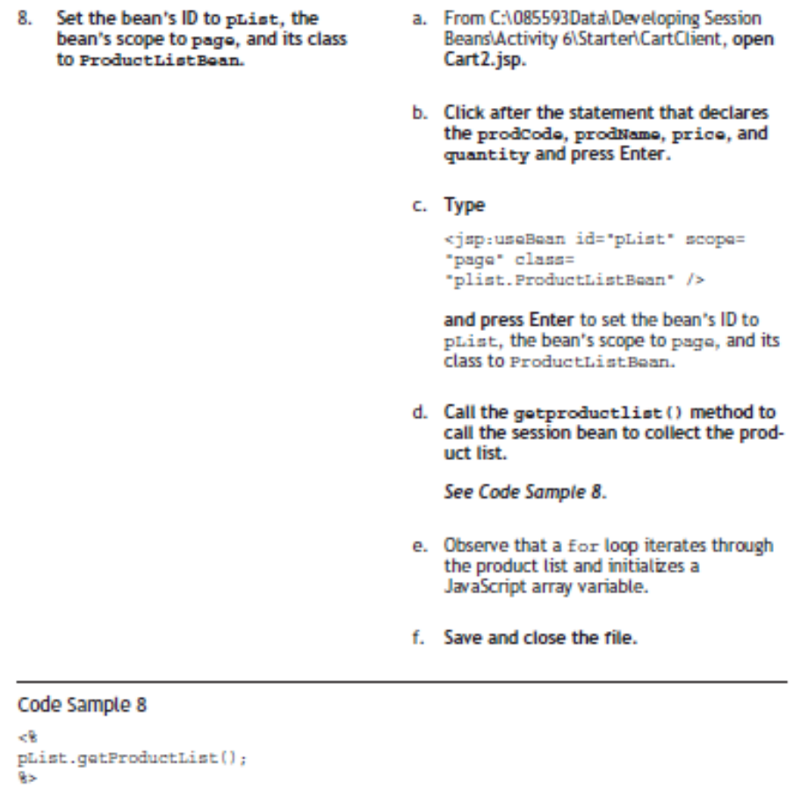
Activity 2-6
Notes:
Instuctor notes:
8. Set the bean’s ID to pList, the
bean’s scope to page, and its class
to ProductListBean.
a. From C:\085593Data\Developing Session
Beans\Activity 6\Starter\CartClient, open
Cart2.jsp.
b. Click after the statement that declares
the prodCode, prodName, price, and
quantity and press Enter.
c. Type
<jsp:useBean id="pList" scope=
"page" class=
"plist.ProductListBean" />
and press Enter to set the bean’s ID to
pList, the bean’s scope to page, and its
class to ProductListBean.
d. Call the getproductlist() method to
call the session bean to collect the product
list.
See Code Sample 8.
e. Observe that a for loop iterates through
the product list and initializes a
JavaScript array variable.
f. Save and close the file.
Code Sample 8
<%
pList.getProductList();
%>

Slide 100
Activity 2-6
What You Do | How You Do It
7. Compile the ProductListBean.java file. | a. At the command prompt, type cd.. and press Enter. b. Type set classpath= %classpath%;C:\085593Data\Developing Session Beans\Activity6\Starter\stateless;.; and press Enter.
Notes:
Instuctor notes:
7. Compile the ProductListBean.java
file.
a. At the command prompt, type
cd..
and press Enter.
b. Type
set classpath=
%classpath%;C:\085593Data\Developing Sess
Beans\Activity
6\Starter\stateless;.;
and press Enter.
c. At the command prompt, type
cd C:\085593Data\Developing
Session Beans\Activity
6\Starter\CartClient\WEB-INF\classes
and press Enter.
d. Type
javac plist\ProductListBean.java
and press Enter to compile
ProductListBean.java.

Slide 101
Activity 2-6
What You Do | How You Do It
7. Compile the ProductListBean.java file. | c. At the command prompt, type cd C:\085593Data\Developing Session Beans\Activity 6\Starter\CartClient\WEB-INF\classes and press Enter. d. Type javac plist\ProductListBean.java and press Enter to compile ProductListBean.java.
Notes:
Instuctor notes:
7. Compile the ProductListBean.java
file.
a. At the command prompt, type
cd..
and press Enter.
b. Type
set classpath=
%classpath%;C:\085593Data\Developing Sess
Beans\Activity
6\Starter\stateless;.;
and press Enter.
c. At the command prompt, type
cd C:\085593Data\Developing
Session Beans\Activity
6\Starter\CartClient\WEB-INF\classes
and press Enter.
d. Type
javac plist\ProductListBean.java
and press Enter to compile
ProductListBean.java.

Slide 102
Activity 2-6
What You Do | How You Do It
8. Set the bean’s ID to pList, the bean’s scope to page, and its class to ProductListBean. | a. From C:\085593Data\Developing SessionBeans\Activity 6\Starter\CartClient, open Cart2.jsp. b. Click after the statement that declares the prodCode, prodName, price, and quantity and press Enter. c. Type <jsp:useBean id="pList" scope= "page" class= "plist.ProductListBean" /> and press Enter to set the bean’s ID to pList, the bean’s scope to page, and its class to ProductListBean.
Notes:
Instuctor notes:
8. Set the bean’s ID to pList, the
bean’s scope to page, and its class
to ProductListBean.
a. From C:\085593Data\Developing Session
Beans\Activity 6\Starter\CartClient, open
Cart2.jsp.
b. Click after the statement that declares
the prodCode, prodName, price, and
quantity and press Enter.
c. Type
<jsp:useBean id="pList" scope=
"page" class=
"plist.ProductListBean" />
and press Enter to set the bean’s ID to
pList, the bean’s scope to page, and its
class to ProductListBean.
d. Call the getproductlist() method to
call the session bean to collect the product
list.
See Code Sample 8.
e. Observe that a for loop iterates through
the product list and initializes a
JavaScript array variable.
f. Save and close the file.
Code Sample 8
<%
pList.getProductList();
%>

Slide 103
Activity 2-6
What You Do | How You Do It
8. Set the bean’s ID to pList, the bean’s scope to page, and its class to ProductListBean. | d. Call the getproductlist() method to call the session bean to collect the product list. See Code Sample 8. e. Observe that a for loop iterates through the product list and initializes a JavaScript array variable. f. Save and close the file.
Code Sample 8 <% pList.getProductList(); %>
Notes:
Instuctor notes:
8. Set the bean’s ID to pList, the
bean’s scope to page, and its class
to ProductListBean.
a. From C:\085593Data\Developing Session
Beans\Activity 6\Starter\CartClient, open
Cart2.jsp.
b. Click after the statement that declares
the prodCode, prodName, price, and
quantity and press Enter.
c. Type
<jsp:useBean id="pList" scope=
"page" class=
"plist.ProductListBean" />
and press Enter to set the bean’s ID to
pList, the bean’s scope to page, and its
class to ProductListBean.
d. Call the getproductlist() method to
call the session bean to collect the product
list.
See Code Sample 8.
e. Observe that a for loop iterates through
the product list and initializes a
JavaScript array variable.
f. Save and close the file.
Code Sample 8
<%
pList.getProductList();
%>

Slide 104
Activity 2-6
What You Do | How You Do It
9. Create an enterprise application for the stateless bean. | a. At the command prompt, type cd C:\085593Data\Developing Session Beans\Activity6\Starter\stateless and press Enter. b. At the command prompt, type jar cvf ProductEjb.jar pview\*.class META-INF\*.xml and press Enter to create productEjb.jar.
Notes:
Instuctor notes:
9. Create an enterprise application for
the stateless bean.
a. At the command prompt, type
cd C:\085593Data\Developing
Session Beans\Activity
6\Starter\stateless
and press Enter.
b. At the command prompt, type
jar cvf ProductEjb.jar
pview\*.class META-INF\*.xml
and press Enter to create ProductEjb.jar.
c. From C:\085593Data\Developing Session
Beans\Activity 6\Starter\stateless, copy
ProductEjb.jar, and paste it in C:\
085593Data\Developing Session Beans\
Activity 6\Starter.
d. At the command prompt, type
cd C:\085593Data\Developing
Session Beans\Activity
6\Starter\CartClient
and press Enter.
e. At the command prompt, type
jar cvf cartweb.war *
and press Enter to create cartweb.war.
f. From C:\085593Data\Developing Session
Beans\Activity 6\Starter\CartClient, copy
cartweb.war and paste it in C:\
085593Data\Developing Session Beans\
Activity 6\Starter.
g. At the command prompt, type
cd..
and press Enter.
h. Type
jar cvf Cart2.ear cartEjb.jar
ProductEjb.jar cartweb.war
META-INF\*.xml
and press Enter to create Cart2.ear.
i. From C:\085593Data\Developing Session
Beans\Activity 5\Starter, copy Cart2.ear
and paste it in C:\JBoss\jboss-4.0.3SP1\
server\default\deploy.
j. At the command prompt, type
cd C:\JBoss\jboss-4.0.3SP1\bin
and press Enter to navigate to the bin
folder.
k. At the command prompt, type
run
and press Enter to run the server.

Slide 105
Activity 2-6
What You Do | How You Do It
9. Create an enterprise application for the stateless bean. | c. From C:\085593Data\Developing SessionBeans\Activity 6\Starter\stateless, copy ProductEjb.jar, and paste it in C:\085593Data\Developing Session Beans\Activity 6\Starter. d. At the command prompt, type cd C:\085593Data\Developing Session Beans\Activity 6\Starter\CartClient and press Enter.
Notes:
Instuctor notes:
9. Create an enterprise application for
the stateless bean.
a. At the command prompt, type
cd C:\085593Data\Developing
Session Beans\Activity
6\Starter\stateless
and press Enter.
b. At the command prompt, type
jar cvf ProductEjb.jar
pview\*.class META-INF\*.xml
and press Enter to create ProductEjb.jar.
c. From C:\085593Data\Developing Session
Beans\Activity 6\Starter\stateless, copy
ProductEjb.jar, and paste it in C:\
085593Data\Developing Session Beans\
Activity 6\Starter.
d. At the command prompt, type
cd C:\085593Data\Developing
Session Beans\Activity
6\Starter\CartClient
and press Enter.
e. At the command prompt, type
jar cvf cartweb.war *
and press Enter to create cartweb.war.
f. From C:\085593Data\Developing Session
Beans\Activity 6\Starter\CartClient, copy
cartweb.war and paste it in C:\
085593Data\Developing Session Beans\
Activity 6\Starter.
g. At the command prompt, type
cd..
and press Enter.
h. Type
jar cvf Cart2.ear cartEjb.jar
ProductEjb.jar cartweb.war
META-INF\*.xml
and press Enter to create Cart2.ear.
i. From C:\085593Data\Developing Session
Beans\Activity 5\Starter, copy Cart2.ear
and paste it in C:\JBoss\jboss-4.0.3SP1\
server\default\deploy.
j. At the command prompt, type
cd C:\JBoss\jboss-4.0.3SP1\bin
and press Enter to navigate to the bin
folder.
k. At the command prompt, type
run
and press Enter to run the server.

Slide 106
Activity 2-6
What You Do | How You Do It
9. Create an enterprise application for the stateless bean. | e. At the command prompt, type jar cvf cartweb.war * and press Enter to create cartweb.war. f. From C:\085593Data\Developing SessionBeans\Activity 6\Starter\CartClient, copy cartweb.war and paste it in C:\085593Data\Developing Session Beans\Activity 6\Starter. g. At the command prompt, type cd.. and press Enter.
Notes:
Instuctor notes:
9. Create an enterprise application for
the stateless bean.
a. At the command prompt, type
cd C:\085593Data\Developing
Session Beans\Activity
6\Starter\stateless
and press Enter.
b. At the command prompt, type
jar cvf ProductEjb.jar
pview\*.class META-INF\*.xml
and press Enter to create ProductEjb.jar.
c. From C:\085593Data\Developing Session
Beans\Activity 6\Starter\stateless, copy
ProductEjb.jar, and paste it in C:\
085593Data\Developing Session Beans\
Activity 6\Starter.
d. At the command prompt, type
cd C:\085593Data\Developing
Session Beans\Activity
6\Starter\CartClient
and press Enter.
e. At the command prompt, type
jar cvf cartweb.war *
and press Enter to create cartweb.war.
f. From C:\085593Data\Developing Session
Beans\Activity 6\Starter\CartClient, copy
cartweb.war and paste it in C:\
085593Data\Developing Session Beans\
Activity 6\Starter.
g. At the command prompt, type
cd..
and press Enter.
h. Type
jar cvf Cart2.ear cartEjb.jar
ProductEjb.jar cartweb.war
META-INF\*.xml
and press Enter to create Cart2.ear.
i. From C:\085593Data\Developing Session
Beans\Activity 5\Starter, copy Cart2.ear
and paste it in C:\JBoss\jboss-4.0.3SP1\
server\default\deploy.
j. At the command prompt, type
cd C:\JBoss\jboss-4.0.3SP1\bin
and press Enter to navigate to the bin
folder.
k. At the command prompt, type
run
and press Enter to run the server.

Slide 107
Activity 2-6
What You Do | How You Do It
9. Create an enterprise application for the stateless bean. | h. Type jar cvf Cart2.ear cartEjb.jar ProductEjb.jar cartweb.war META-INF\*.xml and press Enter to create Cart2.ear. i. From C:\085593Data\Developing Session Beans\Activity 5\Starter, copy Cart2.ear and paste it in C:\JBoss\jboss-4.0.3SP1\server\default\deploy. j. At the command prompt, type cd C:\JBoss\jboss-4.0.3SP1\bin and press Enter to navigate to the bin folder.
Notes:
Instuctor notes:
9. Create an enterprise application for
the stateless bean.
a. At the command prompt, type
cd C:\085593Data\Developing
Session Beans\Activity
6\Starter\stateless
and press Enter.
b. At the command prompt, type
jar cvf ProductEjb.jar
pview\*.class META-INF\*.xml
and press Enter to create ProductEjb.jar.
c. From C:\085593Data\Developing Session
Beans\Activity 6\Starter\stateless, copy
ProductEjb.jar, and paste it in C:\
085593Data\Developing Session Beans\
Activity 6\Starter.
d. At the command prompt, type
cd C:\085593Data\Developing
Session Beans\Activity
6\Starter\CartClient
and press Enter.
e. At the command prompt, type
jar cvf cartweb.war *
and press Enter to create cartweb.war.
f. From C:\085593Data\Developing Session
Beans\Activity 6\Starter\CartClient, copy
cartweb.war and paste it in C:\
085593Data\Developing Session Beans\
Activity 6\Starter.
g. At the command prompt, type
cd..
and press Enter.
h. Type
jar cvf Cart2.ear cartEjb.jar
ProductEjb.jar cartweb.war
META-INF\*.xml
and press Enter to create Cart2.ear.
i. From C:\085593Data\Developing Session
Beans\Activity 5\Starter, copy Cart2.ear
and paste it in C:\JBoss\jboss-4.0.3SP1\
server\default\deploy.
j. At the command prompt, type
cd C:\JBoss\jboss-4.0.3SP1\bin
and press Enter to navigate to the bin
folder.
k. At the command prompt, type
run
and press Enter to run the server.

Slide 108
Activity 2-6
What You Do | How You Do It
9. Create an enterprise application for the stateless bean. | k. At the command prompt, type run and press Enter to run the server.
Notes:
Instuctor notes:
9. Create an enterprise application for
the stateless bean.
a. At the command prompt, type
cd C:\085593Data\Developing
Session Beans\Activity
6\Starter\stateless
and press Enter.
b. At the command prompt, type
jar cvf ProductEjb.jar
pview\*.class META-INF\*.xml
and press Enter to create ProductEjb.jar.
c. From C:\085593Data\Developing Session
Beans\Activity 6\Starter\stateless, copy
ProductEjb.jar, and paste it in C:\
085593Data\Developing Session Beans\
Activity 6\Starter.
d. At the command prompt, type
cd C:\085593Data\Developing
Session Beans\Activity
6\Starter\CartClient
and press Enter.
e. At the command prompt, type
jar cvf cartweb.war *
and press Enter to create cartweb.war.
f. From C:\085593Data\Developing Session
Beans\Activity 6\Starter\CartClient, copy
cartweb.war and paste it in C:\
085593Data\Developing Session Beans\
Activity 6\Starter.
g. At the command prompt, type
cd..
and press Enter.
h. Type
jar cvf Cart2.ear cartEjb.jar
ProductEjb.jar cartweb.war
META-INF\*.xml
and press Enter to create Cart2.ear.
i. From C:\085593Data\Developing Session
Beans\Activity 5\Starter, copy Cart2.ear
and paste it in C:\JBoss\jboss-4.0.3SP1\
server\default\deploy.
j. At the command prompt, type
cd C:\JBoss\jboss-4.0.3SP1\bin
and press Enter to navigate to the bin
folder.
k. At the command prompt, type
run
and press Enter to run the server.

Slide 109
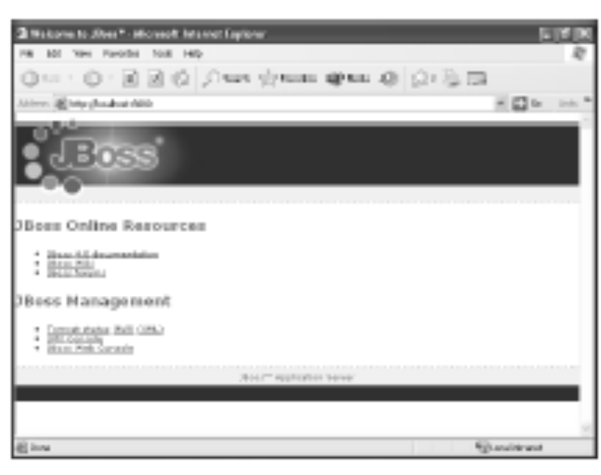
Activity 2-6
10. Create and populate the Product table in the JBoss Hypersonic database.
  a. Open Internet Explorer and navigate to http://localhost:8080/.
Notes:
Instuctor notes:
10. Create and populate the Product
table in the JBoss Hypersonic database.
a. Open Internet Explorer and navigate to
http://localhost:8080/.
b. In the JBoss homepage, under the JBoss
Management section, click the JMX Console
link.
c. In the JMX Agent View page, under the
jboss section, click the
database=localDB,service=Hypersonic
link.
d. In the JMX MBean View page, scroll down
to view the void startDatabaseManager()
section.
e. Under the void startDatabaseManager()
section, click Invoke.
f. Switch to the HSQL Database Manager
window.
g. In the HSQL Database Manager window, in
the SQL pane, type
create table product ( product_id
char(3), product_name varchar(40)
, price double)
and click Execute SQL to create the
product table.
h. Click Clear SQL to clear the query.
i. Insert five rows into the product table.
See Code Sample 9.
LESSON 2
58 EJB3.0
Learning & Knowledge - IBM India
j. Click Execute SQL.
k. Close the HSQL Database Manager window.
Code Sample 9
insert into product values ('101','Mastering Enterprise JavaBeans',100.00)
insert into product values ('102','ASP .NET in 21 Days',75.00)
insert into product values ('103','Beginning Java',100.00)
insert into product values ('104','C#: An Introduction',90.00)
insert into product values ('105','Advanced Java',150.00)

Slide 110
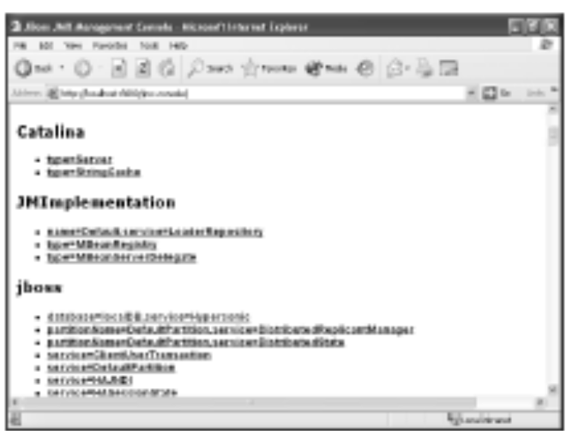
Activity 2-6
10. Create and populate the Product table in the JBoss Hypersonic database.
  b. In the JBoss homepage, under the JBoss Management section, click the JMX Console link.
  c. In the JMX Agent View page, under the
  jboss section, click the database=localDB,service=Hypersonic link.
Notes:
Instuctor notes:
10. Create and populate the Product
table in the JBoss Hypersonic database.
a. Open Internet Explorer and navigate to
http://localhost:8080/.
b. In the JBoss homepage, under the JBoss
Management section, click the JMX Console
link.
c. In the JMX Agent View page, under the
jboss section, click the
database=localDB,service=Hypersonic
link.
d. In the JMX MBean View page, scroll down
to view the void startDatabaseManager()
section.
e. Under the void startDatabaseManager()
section, click Invoke.
f. Switch to the HSQL Database Manager
window.
g. In the HSQL Database Manager window, in
the SQL pane, type
create table product ( product_id
char(3), product_name varchar(40)
, price double)
and click Execute SQL to create the
product table.
h. Click Clear SQL to clear the query.
i. Insert five rows into the product table.
See Code Sample 9.
LESSON 2
58 EJB3.0
Learning & Knowledge - IBM India
j. Click Execute SQL.
k. Close the HSQL Database Manager window.
Code Sample 9
insert into product values ('101','Mastering Enterprise JavaBeans',100.00)
insert into product values ('102','ASP .NET in 21 Days',75.00)
insert into product values ('103','Beginning Java',100.00)
insert into product values ('104','C#: An Introduction',90.00)
insert into product values ('105','Advanced Java',150.00)

Slide 111
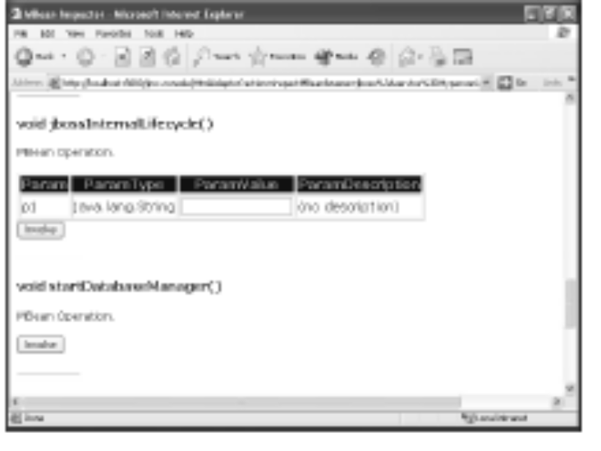
Activity 2-6
10. Create and populate the Product table in the JBoss Hypersonic database.
  d. In the JMX MBean View page, scroll down to view the void startDatabaseManager() section.
  e. Under the void startDatabaseManager() section, click Invoke.
Notes:
Instuctor notes:
10. Create and populate the Product
table in the JBoss Hypersonic database.
a. Open Internet Explorer and navigate to
http://localhost:8080/.
b. In the JBoss homepage, under the JBoss
Management section, click the JMX Console
link.
c. In the JMX Agent View page, under the
jboss section, click the
database=localDB,service=Hypersonic
link.
d. In the JMX MBean View page, scroll down
to view the void startDatabaseManager()
section.
e. Under the void startDatabaseManager()
section, click Invoke.
f. Switch to the HSQL Database Manager
window.
g. In the HSQL Database Manager window, in
the SQL pane, type
create table product ( product_id
char(3), product_name varchar(40)
, price double)
and click Execute SQL to create the
product table.
h. Click Clear SQL to clear the query.
i. Insert five rows into the product table.
See Code Sample 9.
LESSON 2
58 EJB3.0
Learning & Knowledge - IBM India
j. Click Execute SQL.
k. Close the HSQL Database Manager window.
Code Sample 9
insert into product values ('101','Mastering Enterprise JavaBeans',100.00)
insert into product values ('102','ASP .NET in 21 Days',75.00)
insert into product values ('103','Beginning Java',100.00)
insert into product values ('104','C#: An Introduction',90.00)
insert into product values ('105','Advanced Java',150.00)

Slide 112
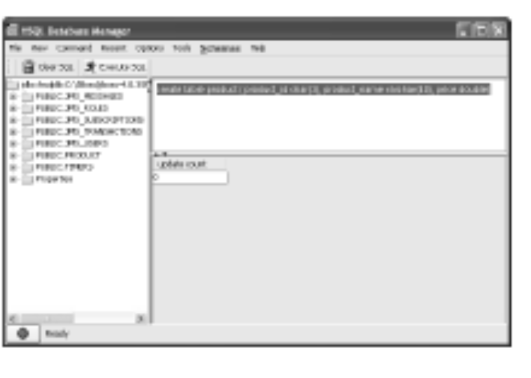
Activity 2-6
10. Create and populate the Product table in the JBoss Hypersonic database.
  f. Switch to the HSQL Database Manager window.
  g. In the HSQL Database Manager window, in the SQL pane, type create table product ( product_id char(3), product_name varchar(40), price double)
  and click Execute SQL to create the product table.
Notes:
Instuctor notes:
10. Create and populate the Product
table in the JBoss Hypersonic database.
a. Open Internet Explorer and navigate to
http://localhost:8080/.
b. In the JBoss homepage, under the JBoss
Management section, click the JMX Console
link.
c. In the JMX Agent View page, under the
jboss section, click the
database=localDB,service=Hypersonic
link.
d. In the JMX MBean View page, scroll down
to view the void startDatabaseManager()
section.
e. Under the void startDatabaseManager()
section, click Invoke.
f. Switch to the HSQL Database Manager
window.
g. In the HSQL Database Manager window, in
the SQL pane, type
create table product ( product_id
char(3), product_name varchar(40)
, price double)
and click Execute SQL to create the
product table.
h. Click Clear SQL to clear the query.
i. Insert five rows into the product table.
See Code Sample 9.
LESSON 2
58 EJB3.0
Learning & Knowledge - IBM India
j. Click Execute SQL.
k. Close the HSQL Database Manager window.
Code Sample 9
insert into product values ('101','Mastering Enterprise JavaBeans',100.00)
insert into product values ('102','ASP .NET in 21 Days',75.00)
insert into product values ('103','Beginning Java',100.00)
insert into product values ('104','C#: An Introduction',90.00)
insert into product values ('105','Advanced Java',150.00)

Slide 113
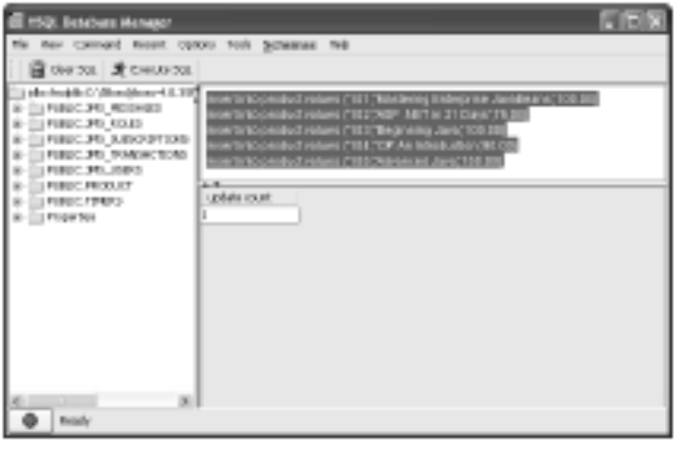
Activity 2-6
10. Create and populate the Product table in the JBoss Hypersonic database.
  h. Click Clear SQL to clear the query.
  i. Insert five rows into the product table.
  See Code Sample 9.
  j. Click Execute SQL.
  k. Close the HSQL Database Manager window.
Notes:
Instuctor notes:
10. Create and populate the Product
table in the JBoss Hypersonic database.
a. Open Internet Explorer and navigate to
http://localhost:8080/.
b. In the JBoss homepage, under the JBoss
Management section, click the JMX Console
link.
c. In the JMX Agent View page, under the
jboss section, click the
database=localDB,service=Hypersonic
link.
d. In the JMX MBean View page, scroll down
to view the void startDatabaseManager()
section.
e. Under the void startDatabaseManager()
section, click Invoke.
f. Switch to the HSQL Database Manager
window.
g. In the HSQL Database Manager window, in
the SQL pane, type
create table product ( product_id
char(3), product_name varchar(40)
, price double)
and click Execute SQL to create the
product table.
h. Click Clear SQL to clear the query.
i. Insert five rows into the product table.
See Code Sample 9.
LESSON 2
58 EJB3.0
Learning & Knowledge - IBM India
j. Click Execute SQL.
k. Close the HSQL Database Manager window.
Code Sample 9
insert into product values ('101','Mastering Enterprise JavaBeans',100.00)
insert into product values ('102','ASP .NET in 21 Days',75.00)
insert into product values ('103','Beginning Java',100.00)
insert into product values ('104','C#: An Introduction',90.00)
insert into product values ('105','Advanced Java',150.00)

Slide 114
Activity 2-6
Code Sample 9
insert into product values ('101','Mastering Enterprise JavaBeans',100.00)
insert into product values ('102','ASP .NET in 21 Days',75.00)
insert into product values ('103','Beginning Java',100.00)
insert into product values ('104','C#: An Introduction',90.00)
insert into product values ('105','Advanced Java',150.00)
Go back
Notes:
Instuctor notes:
10. Create and populate the Product
table in the JBoss Hypersonic database.
a. Open Internet Explorer and navigate to
http://localhost:8080/.
b. In the JBoss homepage, under the JBoss
Management section, click the JMX Console
link.
c. In the JMX Agent View page, under the
jboss section, click the
database=localDB,service=Hypersonic
link.
d. In the JMX MBean View page, scroll down
to view the void startDatabaseManager()
section.
e. Under the void startDatabaseManager()
section, click Invoke.
f. Switch to the HSQL Database Manager
window.
g. In the HSQL Database Manager window, in
the SQL pane, type
create table product ( product_id
char(3), product_name varchar(40)
, price double)
and click Execute SQL to create the
product table.
h. Click Clear SQL to clear the query.
i. Insert five rows into the product table.
See Code Sample 9.
LESSON 2
58 EJB3.0
Learning & Knowledge - IBM India
j. Click Execute SQL.
k. Close the HSQL Database Manager window.
Code Sample 9
insert into product values ('101','Mastering Enterprise JavaBeans',100.00)
insert into product values ('102','ASP .NET in 21 Days',75.00)
insert into product values ('103','Beginning Java',100.00)
insert into product values ('104','C#: An Introduction',90.00)
insert into product values ('105','Advanced Java',150.00)

Slide 115
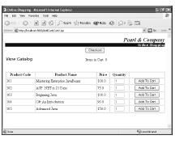
Activity 2-6
11. Run the application.
  a. Open Internet Explorer and navigate to http://localhost:8080/AddCart/Cart2.jsp.
  b. Click Add To Cart for the products you want to purchase.
  c. Click Checkout to check out the items from the cart.
  d. Close the browser window.
Notes:
Instuctor notes:
11. Run the application. a. Open Internet Explorer and navigate to
http://localhost:8080/AddCart/
Cart2.jsp.
b. Click Add To Cart for the products you
want to purchase.
c. Click Checkout to check out the items
from the cart.
d. Close the browser window.
e. Stop the server and terminate the batch
process.
f. Type
exit
and press Enter.

Slide 116
Activity 2-6
11. Run the application.
  e. Stop the server and terminate the batch process.
  f. Type
  exit
  and press Enter.
Notes:
Instuctor notes:
11. Run the application. a. Open Internet Explorer and navigate to
http://localhost:8080/AddCart/
Cart2.jsp.
b. Click Add To Cart for the products you
want to purchase.
c. Click Checkout to check out the items
from the cart.
d. Close the browser window.
e. Stop the server and terminate the batch
process.
f. Type
exit
and press Enter.

Slide 117
Module Review
In this module, you created a stateful session bean to store items in a virtual shopping cart and a stateless session bean to create a recordset of the products displayed on a catalog web page.
By using a session bean, you can reduce the application development time, since the container provides many of the system-level services.
How do you determine the appropriate session bean to use for your application?
Why should you use the business interface for a session bean while developing an application?
Notes:
Instructor notes:
In this module, you created a stateful session bean to store items in a virtual shopping cart and
a stateless session bean to create a recordset of the products displayed on a catalog web page.
By using a session bean, you can reduce the application development time, since the container
provides many of the system-level services.
1. How do you determine the appropriate session bean to use for your application?
Answers will vary.
2. Why should you use the business interface for a session bean while developing an
application?
Answers will vary.

Slide 118

Module Summary
Having completed this topic, you should be able to:
  Decide on an appropriate type of session bean.
  Create a remote interface for a session bean.
  Create a session bean implementation class.
  Create a client class for a session bean.
  Deploy a session bean component.
  Create a stateless session bean.

Slide 119

Congratulations!
Congratulations for completing this module!
Thanks for your participation!

